Slide 1

Better Together: Text + Context Final Presentation
Aug 3, 2023
https://github.com/kwchurch/JSALT_Better_Together

Slide 2
Agenda
1.5 hours
1.5 hours
Intro (Ken) – 20 min
Centroids/Related Work
(Rodolfo) – 15 min
Bins
(Shabnam) – 15 min
Forecasting over time
Losses + Time & Space
Production Runs
(Ben) – 10 min
Time & Space
Break – 30 minutes
Experiments
Perplexity (Abteen) – 20 min
Random Walks (Peter) – 10 min
Local Citation Prediction (Peter) – 10 min
Time prediction (Melissa) – 15 min
GNNs (Sandeep, Hui) – 15 min
Deliverables/Conclusions
(Ken) – 5 minutes
Questions – 15 min

Slide 3
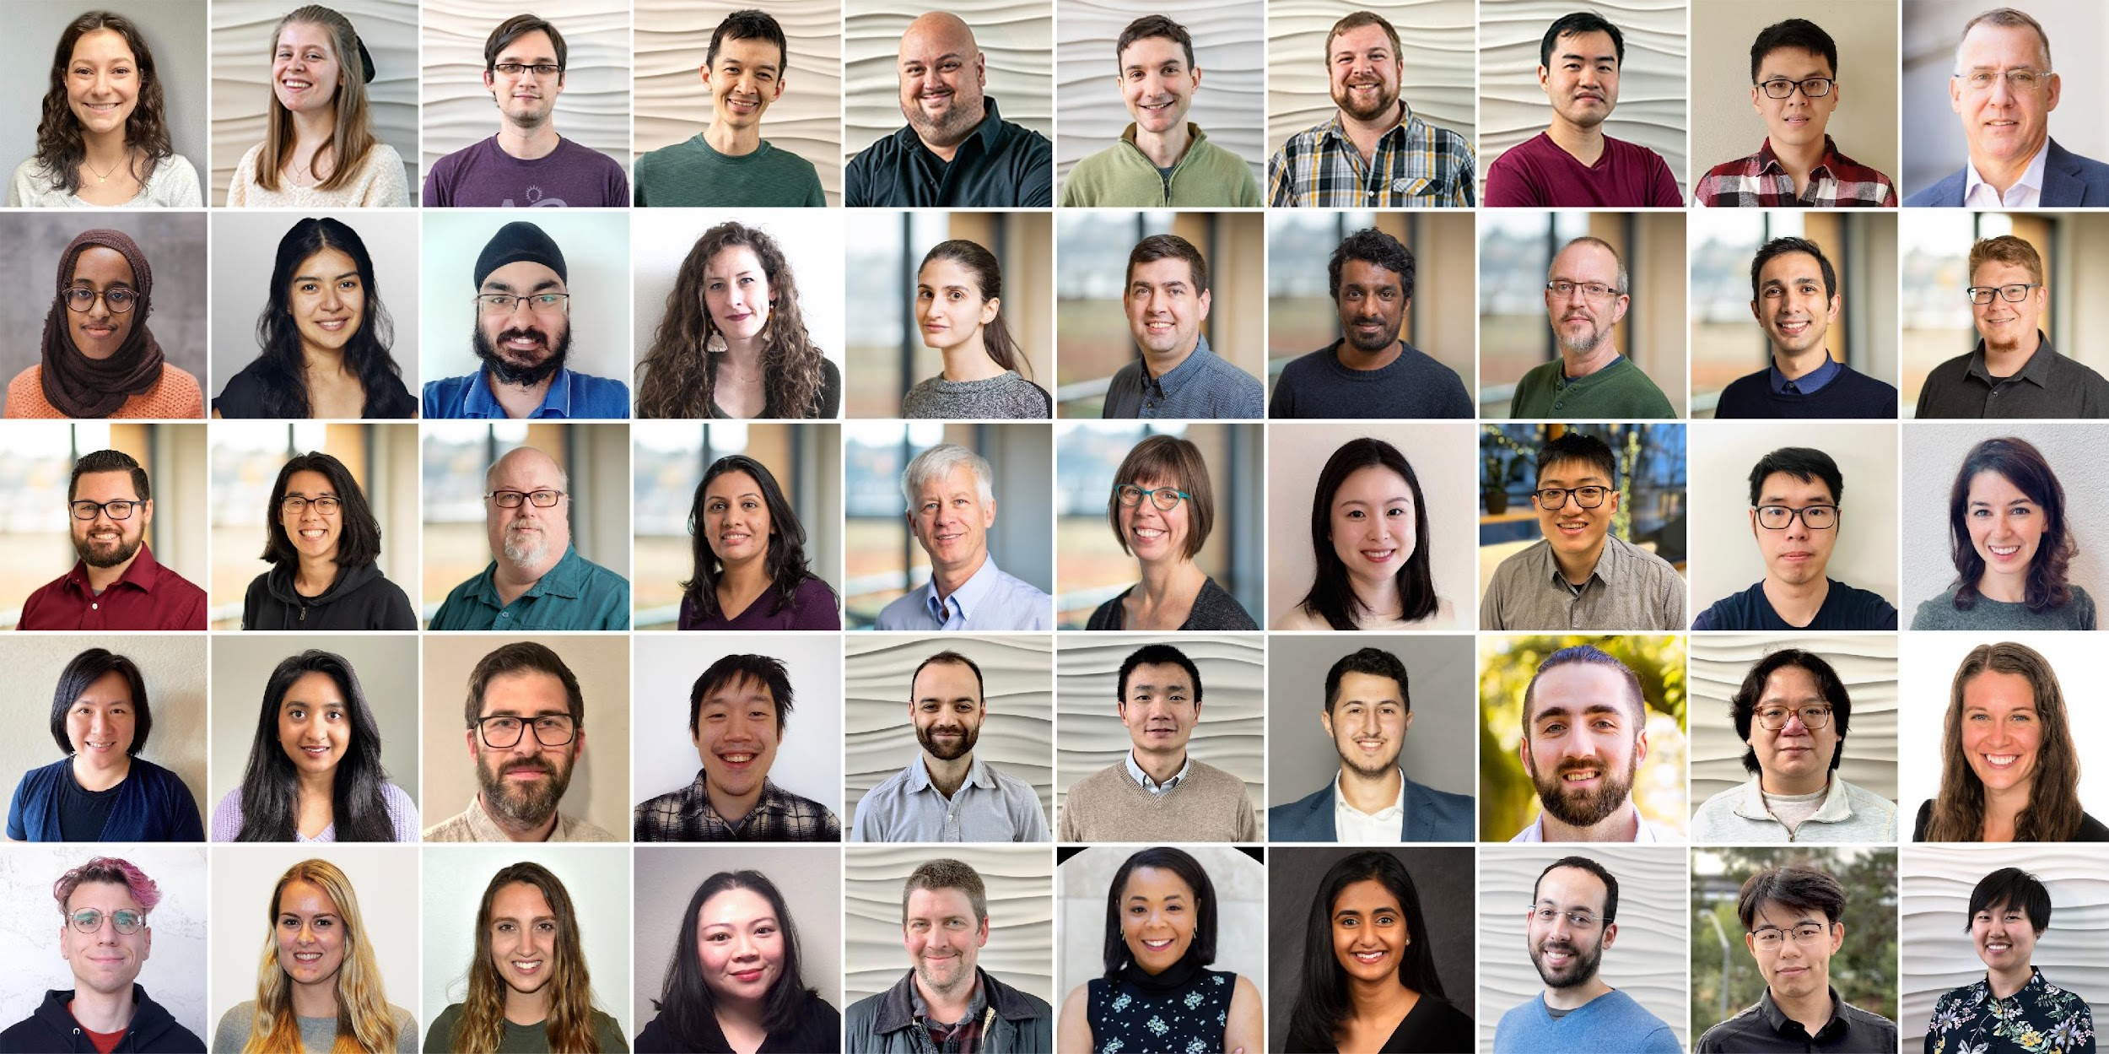
Semantic Scholar (S2): Significant Effort (slide from Dan Weld)
50 person team
7 year project
207M+ scientific paper index
8M+ monthly active users

Slide 4
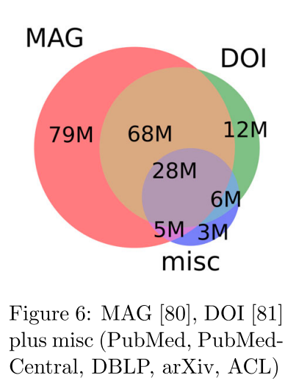
Semantic Scholar (S2)
Seven Sources
Fields of Study
Medicine (45M) | Engineering (8M) | Business (4M) | Geology (3M)
Chemistry (13M) | Physics (7M) | Sociology (3M) | History (2M)
Computer Science (13M) | Psychology (7M) | Geography (3M) | Art (2M)
Biology (13M) | Mathematics (5M) | Economics (3M) | Philosophy (1M)
Materials Science (10M) | Political Science (4M) | Environmental Science (3M)

Slide 5
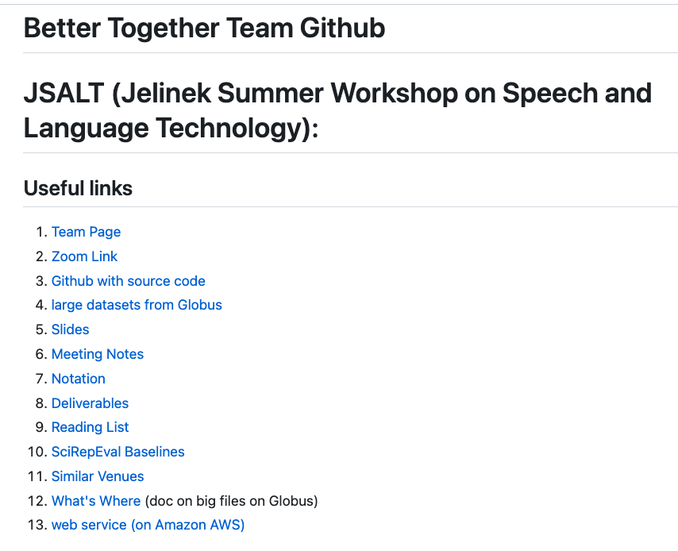
https://github.com/kwchurch/JSALT_Better_Together
including these slides
Web Page

Slide 6
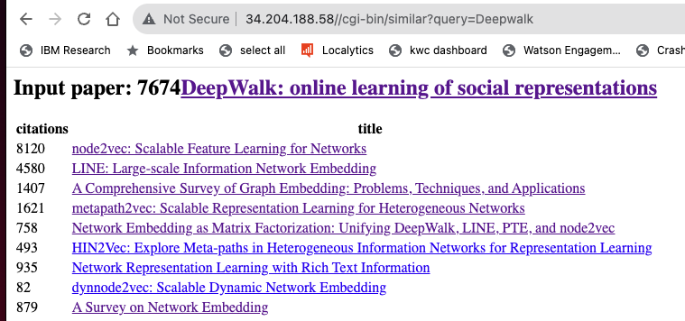

Web Page

Slide 7
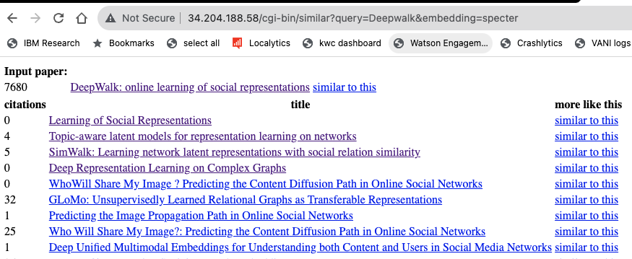
Web Page (Specter)

Slide 8

Better Together: Text (Titles, Abstracts, Body); Context (Citations)
Specter, SciNCL
ProNE

Slide 9
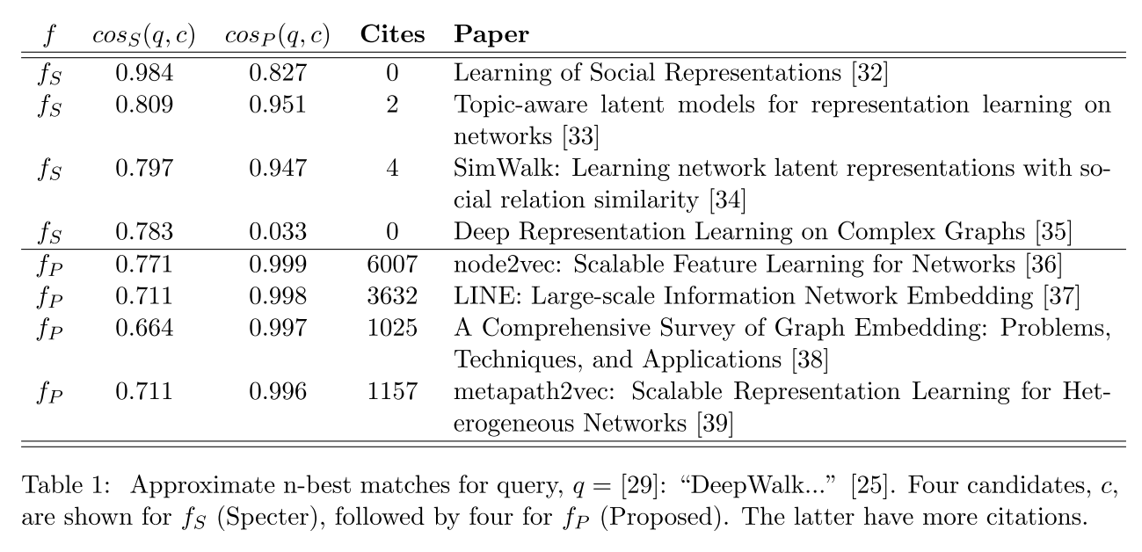
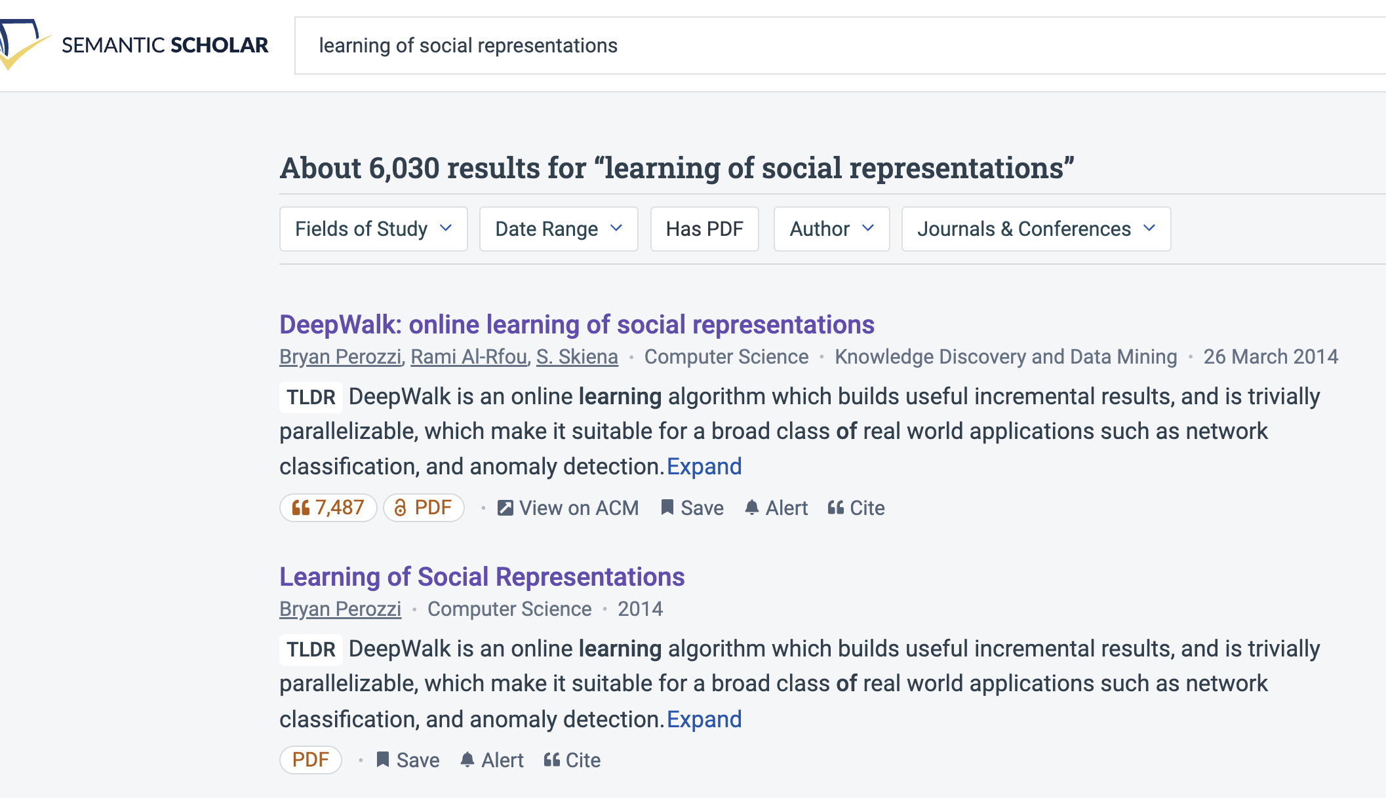
Query: ``DeepWalk: Online Learning of…’’

Slide 10
Recommendation: More than Word Overlap
Recommendations
What should I read?
What should I cite?
Many systems focus on ``relevance’’ (word overlap)
But we also want credibility
Don’t recommend papers that are buzz-word compliant
But not worth reading
(Most papers are never cited)

Slide 11
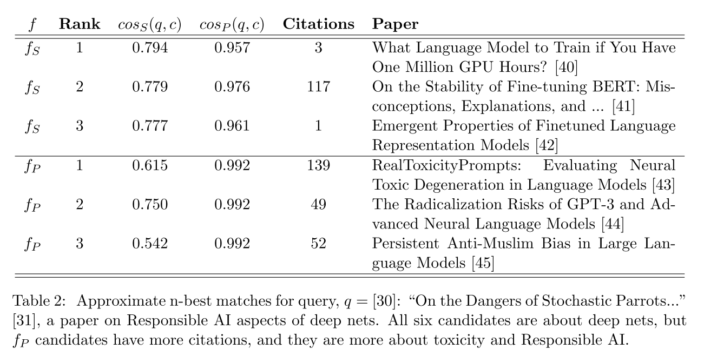
Query: ``On the Dangers of Stochastic Parrots…’’

Slide 12
Deliverables
GitHub:
massive (but needs editing)
slides, code, reading list
pointers to large files on Globus
Web Server
Recommendations
Input: queries for documents
Output: recommendations (docs)
What Should I read? Cite?
Resources
Data behind web server:
citation graph
embeddings
indexes for approx. nearest neighbors
pairs of corpusIds with large cosines
all of the above for
Specter1, Specter2, SciNCL, ProNE
x100 bins for ProNE
Evaluations & Benchmarks
Intrinsic: Perplexity, Random Walks
Extrinsic: Local Citation Prediction

Slide 13
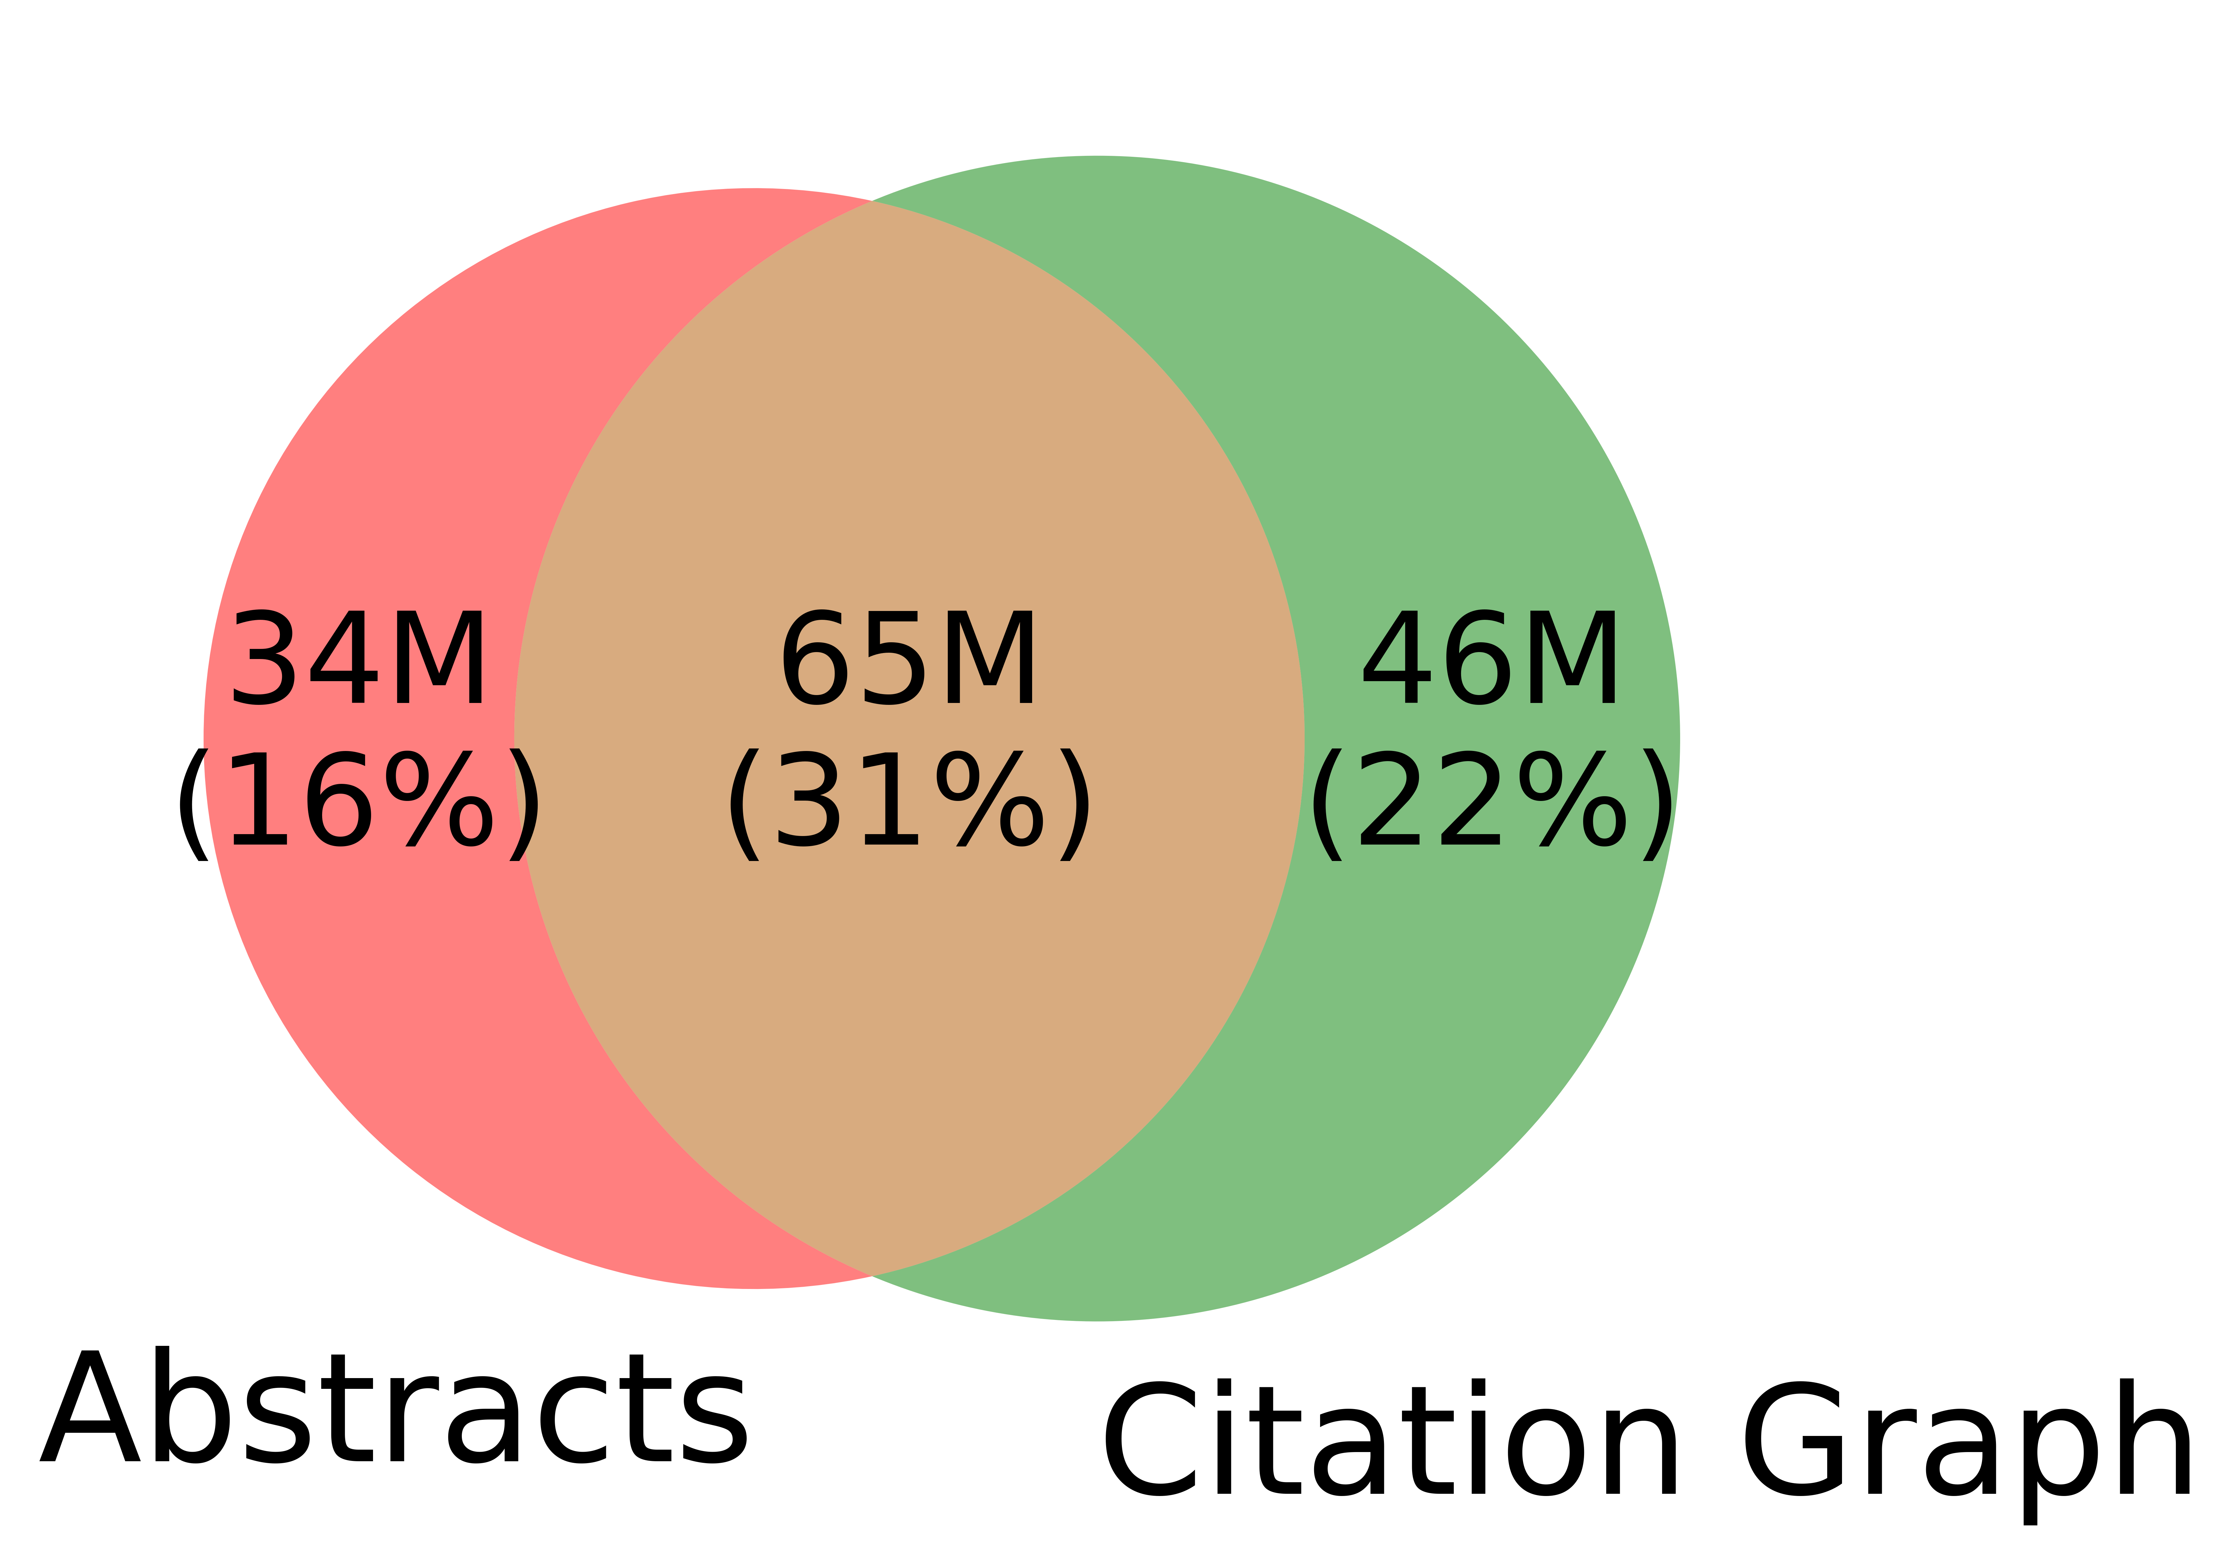
Spoiler Alert: Better-Together Conjectures
Multiple representations are helpful
for missing values (and bad values)
If abstracts are missing, use links
If links are missing, use abstracts
and for graphs of different sizes
When graphs are small (benchmarks):
Text >> Links
when graphs are large:
Links >> Text (Metcalfe’s Law)
Other
31%

Slide 14
Opportunities
Scale
Prediction
Many benchmarks return a single number (figure of merit)
How does performance scale
with the size of the problem?
Standard test/train splits
More relevant to interpolation
than extrapolation
Time is asymmetric
It is difficult to make predictions
especially about the future
-- Yogi Berra

Slide 15
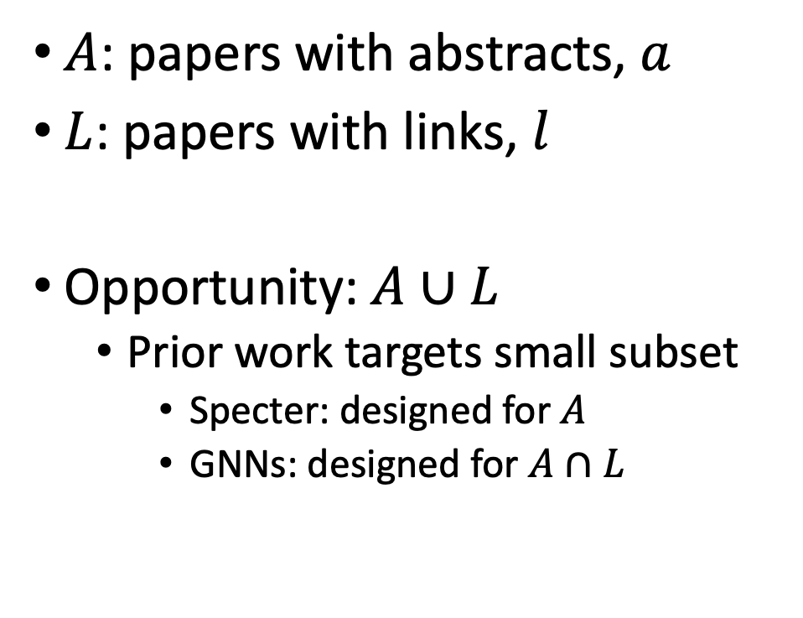
Realities: Missing Values
$A$: papers with abstracts, $a$
$L$: papers with links, $l$
Opportunity:$A∪L$
Prior work targets small subset
Specter: designed for $A$
GNNs: designed for $A∩L$
Other
31%

Slide 16
Opportunity: More Realistic Benchmarks
The Real World
Idealizations (Standard Benchmarks)
Large (Metcalfe’s Law)
Growing (next slide)
Dirty (previous slide)
Missing Values
Bad/misleading Values
Small
Static
Clean

Slide 17
Large & Growing: Doubles Every 9 Years
Standard Benchmarks: OGB
Small: 3M << 200M
Static: Frozen since KDD-2021
https://arxiv.org/abs/2103.09430
Timeliness
Web companies keep indexes up to date (web is a moving target)
Ditto for Academic Search

Slide 18
Standard Benchmarks (e.g., OGB, SciRepEval) are Small, Static & Clean
OGB (Open Graph Benchmark)
S2 (Semantic Scholar)
https://arxiv.org/pdf/2005.00687.pdf
Nodes (papers): 3M (small)
Static
(Frozen for KDD-2021 CUP)
Train: before 2017
Validation: 2018
Test: 2019
Nearly all papers have both
Vectors (from word2vec)
Links (from citation graph)
Nodes (papers): 200+ M
Dynamic
Doubles every 9 years
Many papers with missing values
Many missing vectors
(because of missing abstracts)
Many missing links

Slide 19
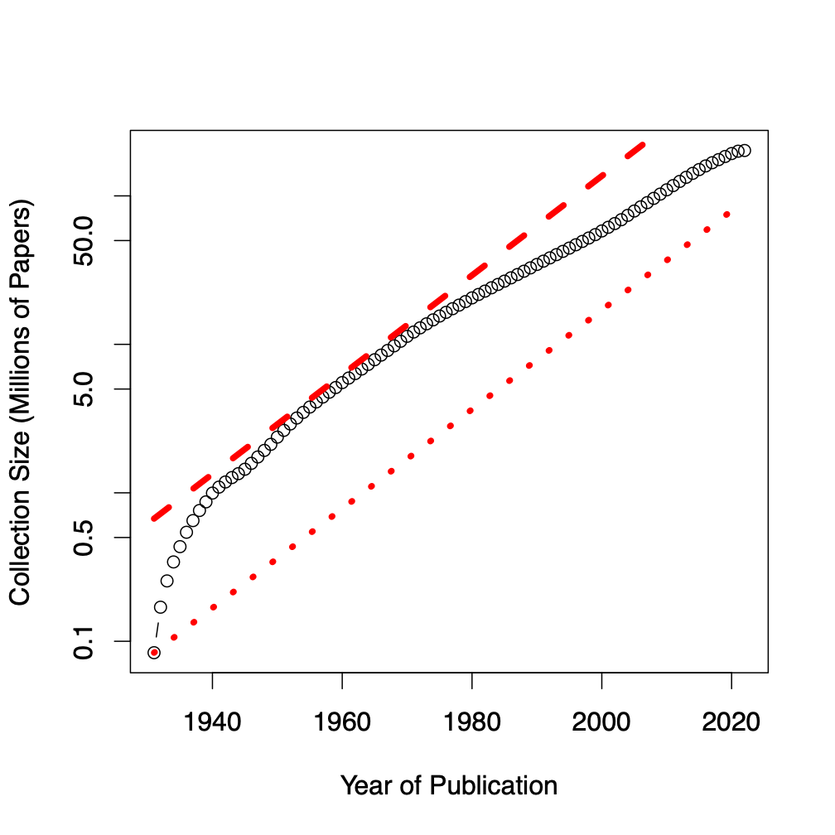
Benchmarks
Dataset | #N | #E | Node Raw Features
ogbl-citation2 | 3M | 31M | 128 (eg. word2vec)
Semantic scholar | 200M | 2B | 768 (eg. Bert)
GBs → TBs
Notes:
Graph showing growth

Slide 20
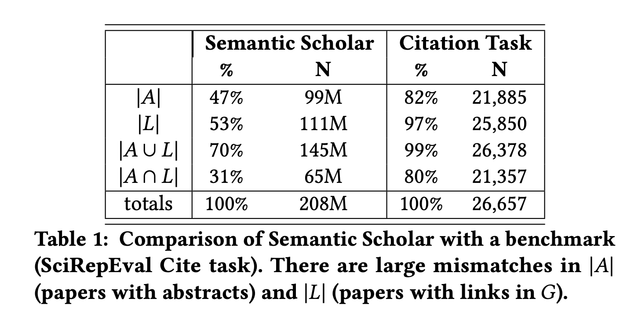
Standard Benchmarks are Small, Static & Clean
S2 (Semantic Scholar)
SciRepEval: Fewer Missing Values

Slide 21
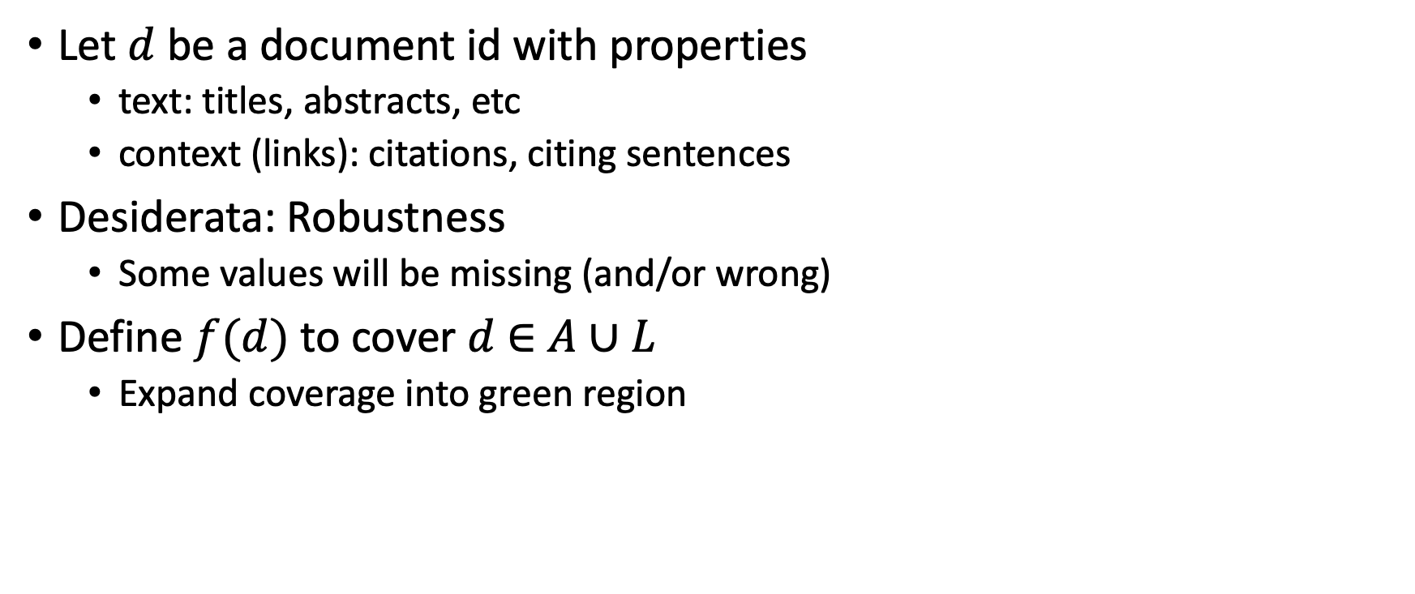

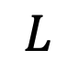
Suggestion for Missing Values
Let $d$ be a document id with properties
text: titles, abstracts, etc
context (links): citations, citing sentences
Desiderata: Robustness
Some values will be missing (and/or wrong)
Define $f(d)$ to cover $d$ $∈$ $A∪L$
Expand coverage into green region
$$A$$
$$L$$

Slide 22
Teaser for Rodolfo’s Talk
Coming next…
How do we estimate vectors for new papers (not in training set)?

Slide 23
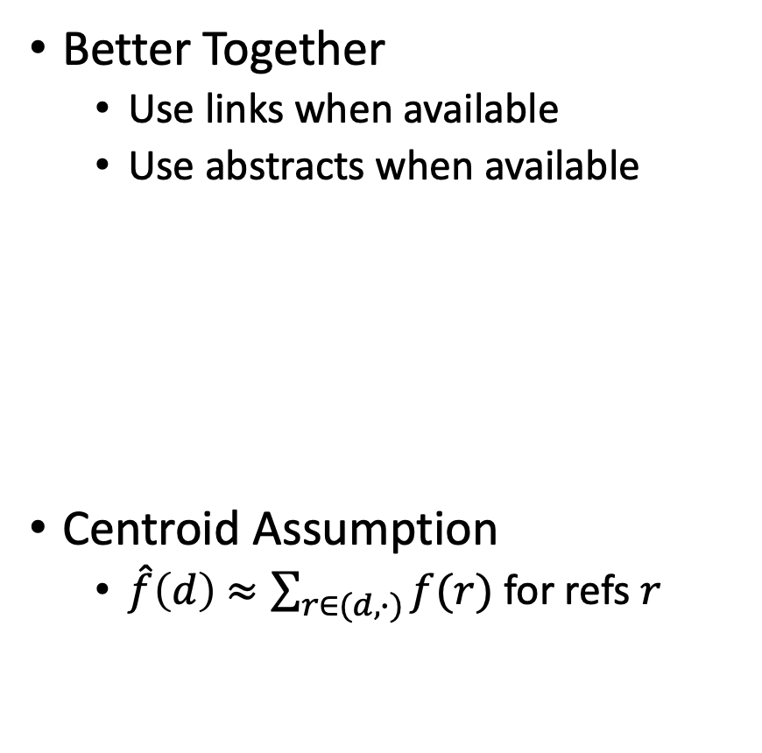

Estimates of $f(d)$ for $d$ $∉$ training set
It has been suggested that Link-based methods
do not generalize to documents beyond training set
Two methods for generalizing
Better Together
Centroid Assumption
Rodolfo & Peter
Better Together
Use links when available
Use abstracts when available
Centroid Assumption
$\hat{f}\left(d\right)$ $≈\sum_{r∈(d,∙)}{f(r)}$ for refs $r$

Slide 24
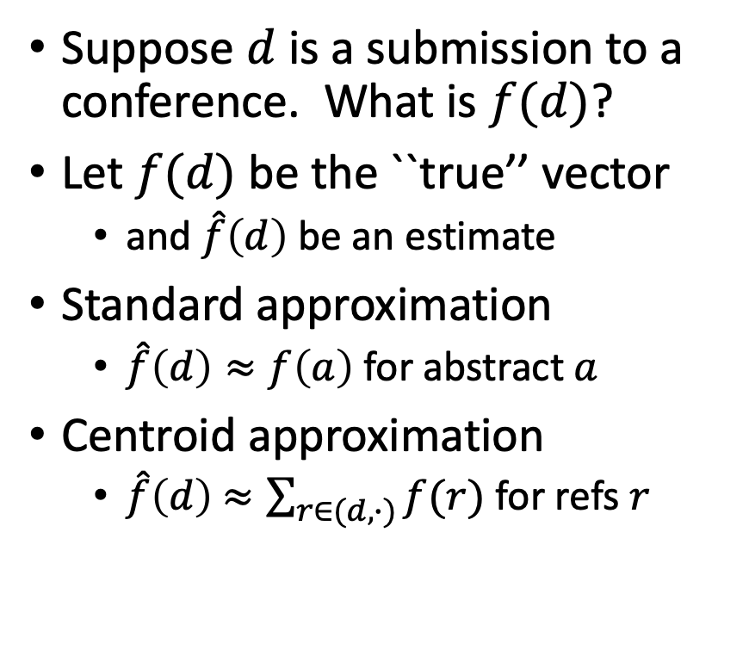
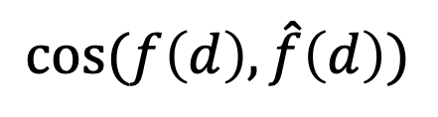
Centroid Assumption
Evidence for Centroid Approximation
$$cos⁡(f\left(d\right), \hat{f}\left(d\right))$$
Suppose $d$ is a submission to a conference. What is $f(d)$?
Let $f(d)$ be the ``true’’ vector
and $\hat{f}\left(d\right)$ be an estimate
Standard approximation
$\hat{f}\left(d\right)≈f\left(a\right)$ for abstract $a$
Centroid approximation
$\hat{f}\left(d\right)$ $≈\sum_{r∈(d,∙)}{f(r)}$ for refs $r$

Slide 25
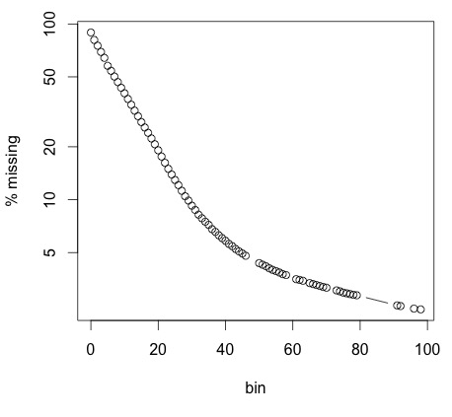
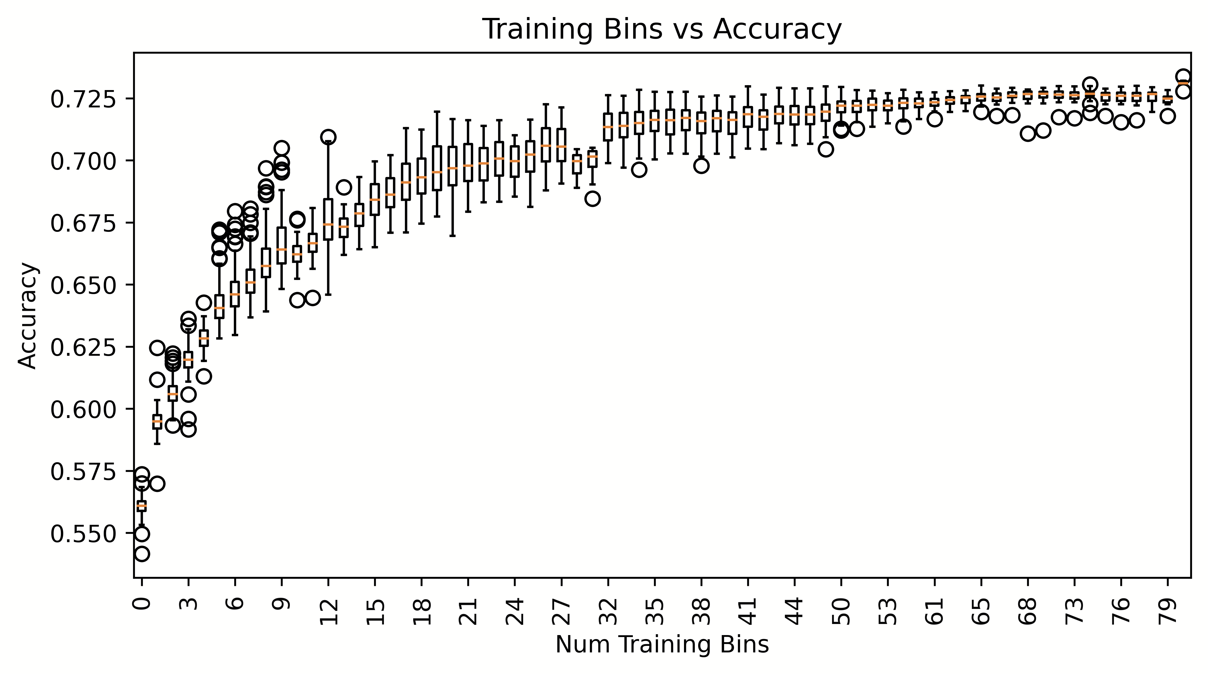
Proposal: Bins (Shabnam)
Research Questions:
How does performance/coverage scale
with size of citation graph?
How do losses scale with time?
Weather forecasting:
Short-term is easier than long-term
Better together:
Multiple reps → Ensembles
Production Runs
100x more work
Coverage
Peter (gain)
Ben (pain)
Performance

Slide 26
Resources & Evaluations: How do losses scale with size of citation graph?
We will distribute
Bins: CorpusIds
Graphs & Embeddings for bins
with indexes for ANN
Benchmarks for Experiments
Intrinsic
Perplexity
Random Walk
Year Prediction
Related-Work Hypothesis
Extrinsic
Local Citation Prediction
Experimental Results
Perplexity Experiments
Abteen
Random Walk Experiments
Peter, Ken
Link Prediction Experiments
Peter
Year Prediction
Melissa, Shabnam
Related-Work Hypothesis
Rodolfo, John

Slide 27
How do time and space scale with size of graph?
Embeddings
Standard Embeddings
Specter, SciNCL, LinkBERT
Proposed embedding (ProNE)
Ben, Ken

Slide 28
Approximate Nearest Neighbors in External Memory
Kenneth Church

Slide 29
Opportunity for Publication
Well established:
Memory resident solutions (annoy)
Novelty:
External memory
mmap
Embarrassingly parallel
Standard evaluation benchmark
https://ann-benchmarks.com/
May not address advantages of proposed solution
Indexing time: small memory footprint during indexing, embarrassingly parallel
Inference time: small memory footprint, quick startup

Slide 30
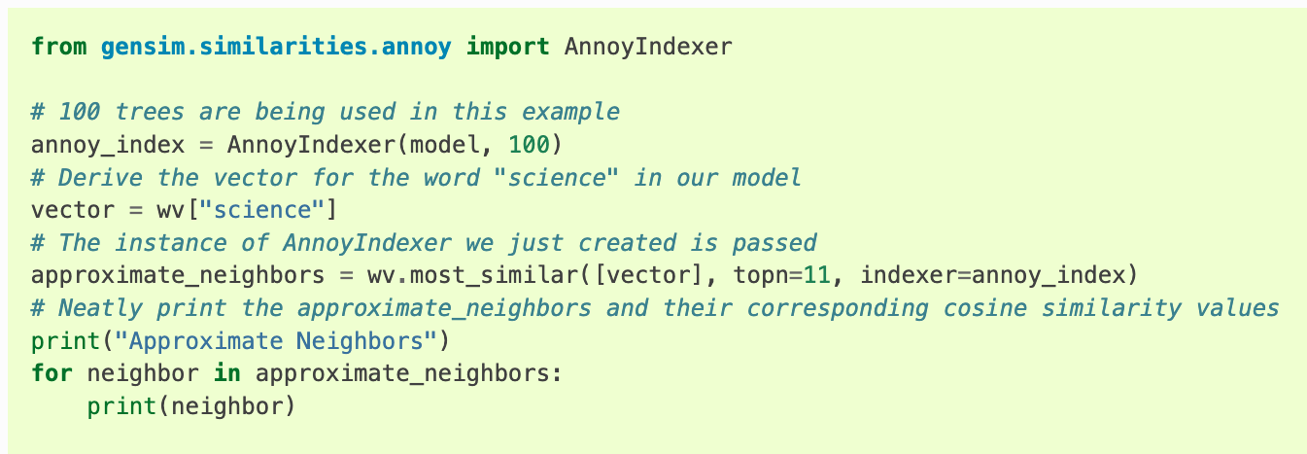
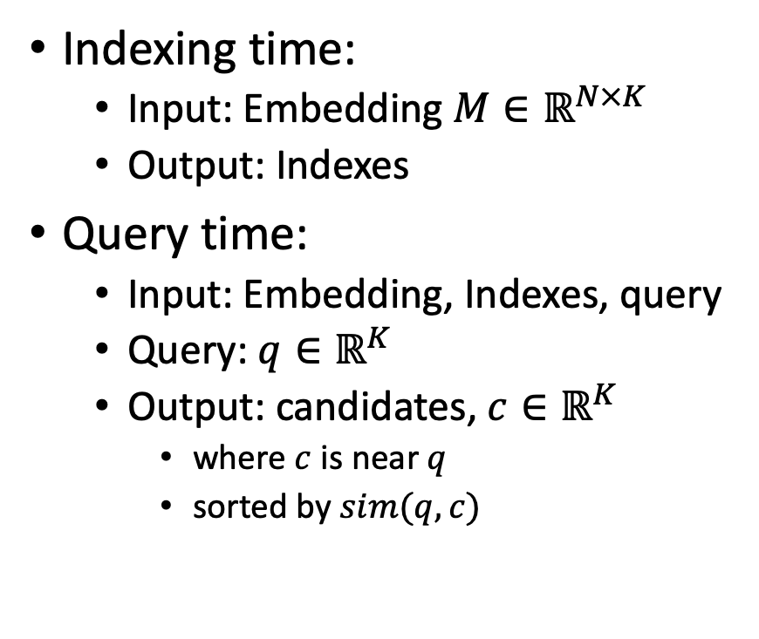
Processing with Embeddings: Annoy / Faiss Approximate Nearest Neighbors (ANN)
Indexing time:
Input: Embedding $M∈ℝ^{N×K}$
Output: Indexes
Query time:
Input: Embedding, Indexes, query
Query: $q∈ℝ^{K}$
Output: candidates, $c∈ℝ^{K}$
where $c$ is near $q$
sorted by $sim(q,c)$
https://radimrehurek.com/gensim/auto_examples/tutorials/run_annoy.html

Slide 31
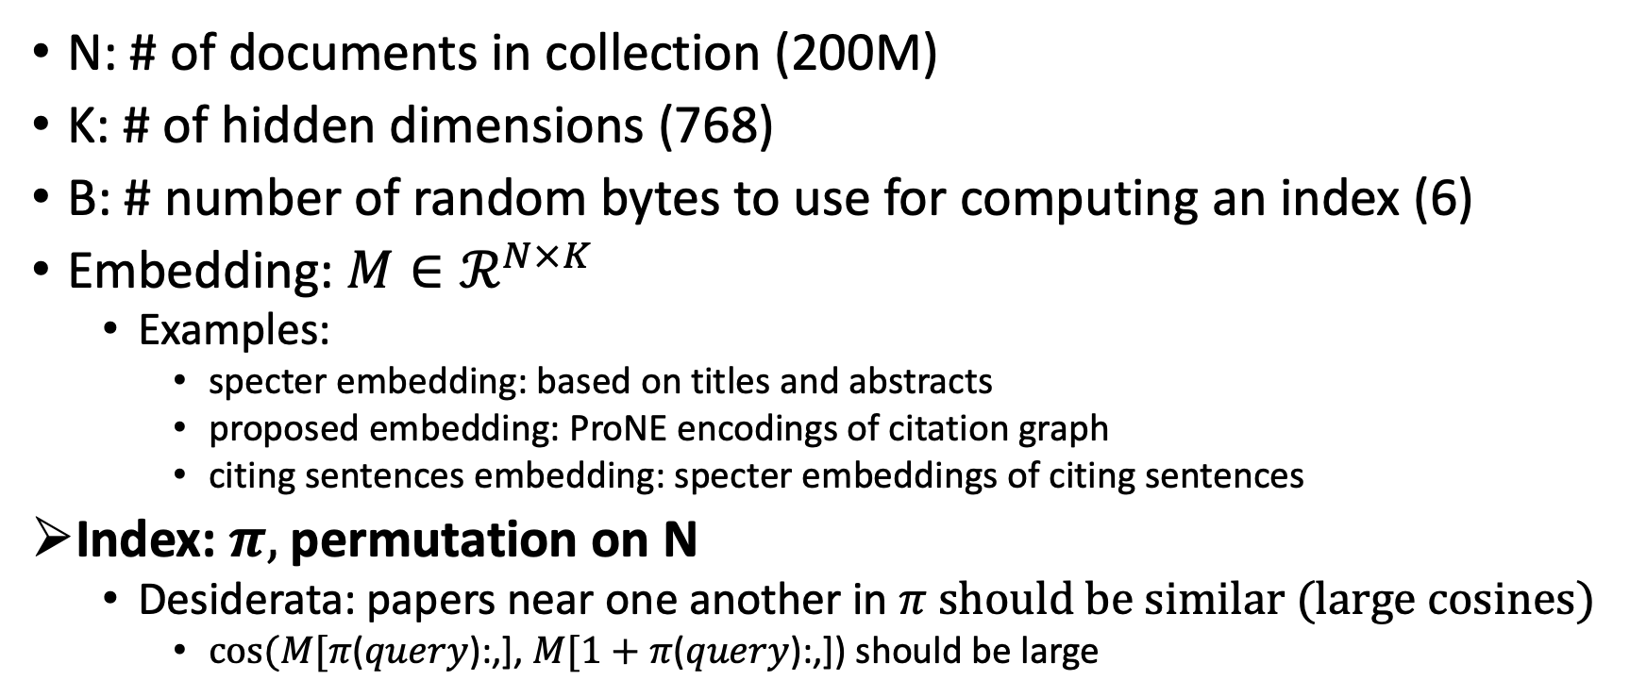
Notation
N: # of documents in collection (200M)
K: # of hidden dimensions (768)
B: # number of random bytes to use for computing an index (6)
Embedding: $M∈ℛ^{N×K}$
Examples:
specter embedding: based on titles and abstracts
proposed embedding: ProNE encodings of citation graph
citing sentences embedding: specter embeddings of citing sentences
Index: $π,$permutation on N
Desiderata: papers near one another in $π$ should be similar (large cosines)
$cos⁡(M[π$($query$):,], $M[1+π$($query$):,]) should be large

Slide 32
Memory Mapping (mmap in C; numpy.memmap in Python)
def map_int64(fn):
fn_len = os.path.getsize(fn)
return np.memmap(fn, dtype=np.int64, shape=(int(fn_len/8)), mode='r')
longs = (long *)mmapfile(av[++i], &nlongs);
nlongs /= sizeof(long);
Loads a large file (embedding) quickly
by adding file on disk to page table (without copying the contents)
returns a pointer to the contents (and the size of object in bytes)
If you dereference a pointer to virtual memory,
there could be a page fault (if the page is not in physical memory)

Slide 33
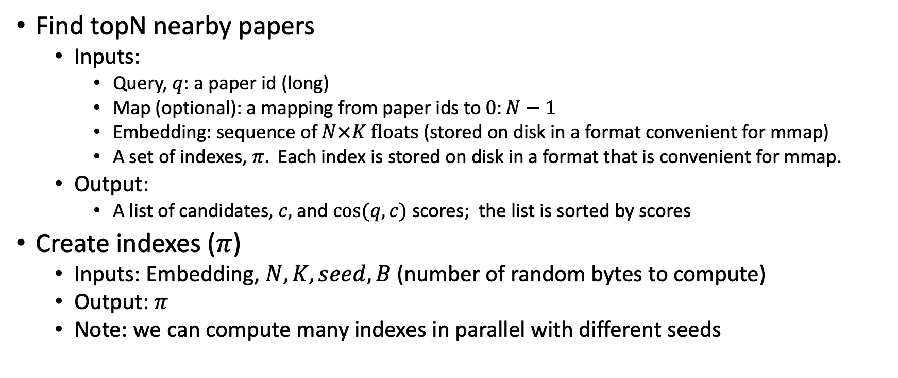
Problems to be done in external memory (Avoid loading embedding into memory)
Find topN nearby papers
Inputs:
Query, $q$: a paper id (long)
Map (optional): a mapping from paper ids to $0:N−1$
Embedding: sequence of $N×K floats$ (stored on disk in a format convenient for mmap)
A set of indexes, $π.$ Each index is stored on disk in a format that is convenient for mmap.
Output:
A list of candidates, $c,$ and $cos⁡(q,c)$ scores; the list is sorted by scores
Create indexes ($π$)
Inputs: Embedding, $N, K, seed, B$(number of random bytes to compute)
Output: $π$
Note: we can compute many indexes in parallel with different seeds

Slide 34

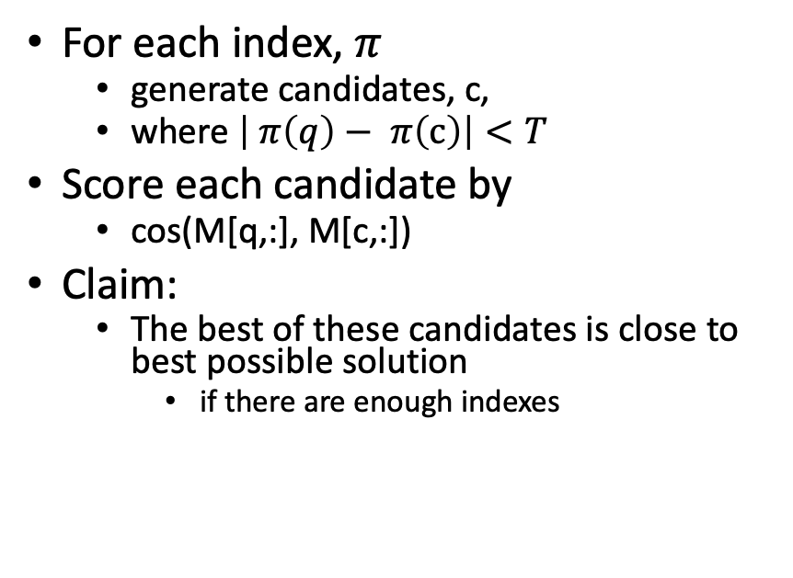
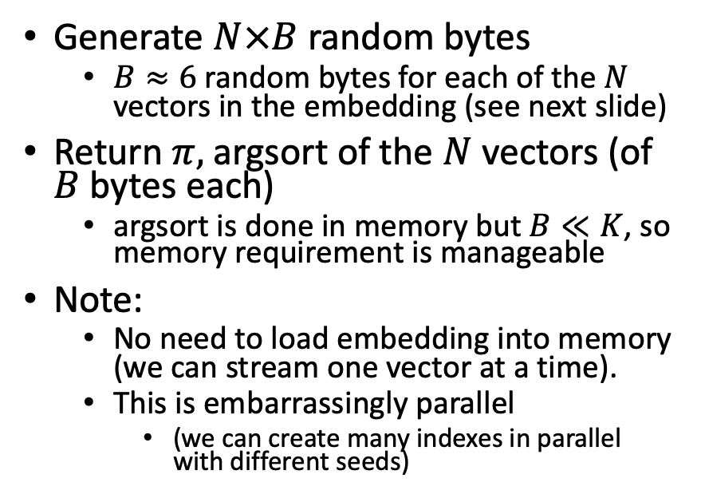
Solutions
Find topN nearby papers (easy)
Create index $π$
For each index, $π$
generate candidates, c,
where $\left| π\left(q\right)− π\left(c\right)\right|<T$
Score each candidate by
cos(M[q,:], M[c,:])
Claim:
The best of these candidates is close to best possible solution
if there are enough indexes
Generate $N×B$ random bytes
$B≈6$ random bytes for each of the $N$ vectors in the embedding (see next slide)
Return $π,$argsort of the $N$vectors (of $B$ bytes each)
argsort is done in memory but $B≪K$, so memory requirement is manageable
Note:
No need to load embedding into memory (we can stream one vector at a time).
This is embarrassingly parallel
(we can create many indexes in parallel with different seeds)

Slide 35
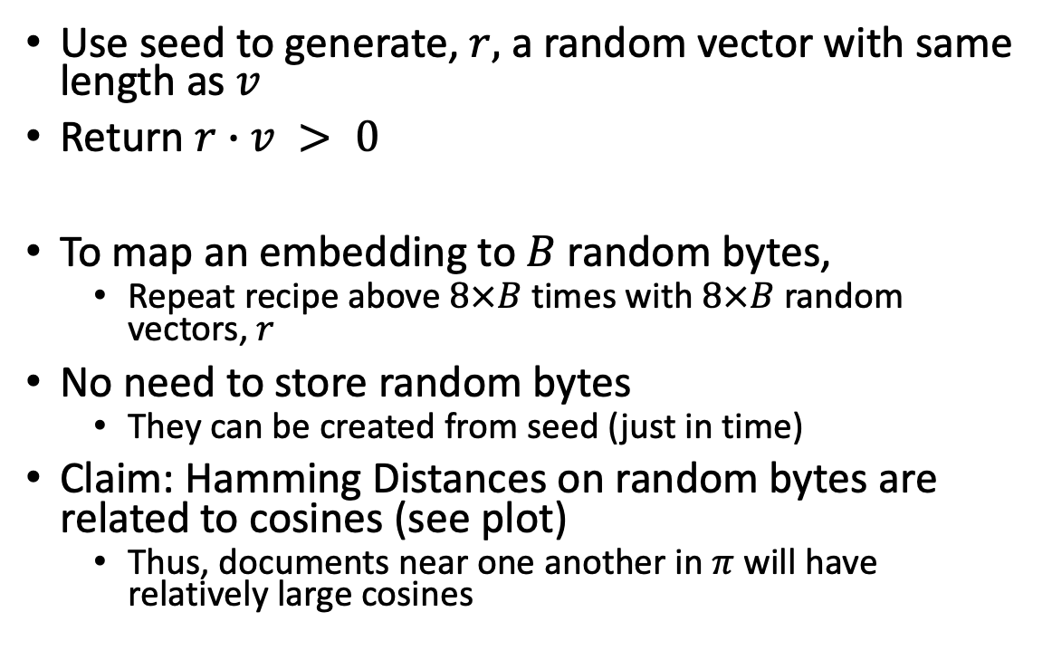

Method for mapping vector, $v$, to 1 bit
Use seed to generate, $r,$ a random vector with same length as $v$
Return $r∙v > 0$
To map an embedding to $B$ random bytes,
Repeat recipe above $8×B$ times with $8×B$ random vectors, $r$
No need to store random bytes
They can be created from seed (just in time)
Claim: Hamming Distances on random bytes are related to cosines (see plot)
Thus, documents near one another in $π$ will have relatively large cosines

Slide 36
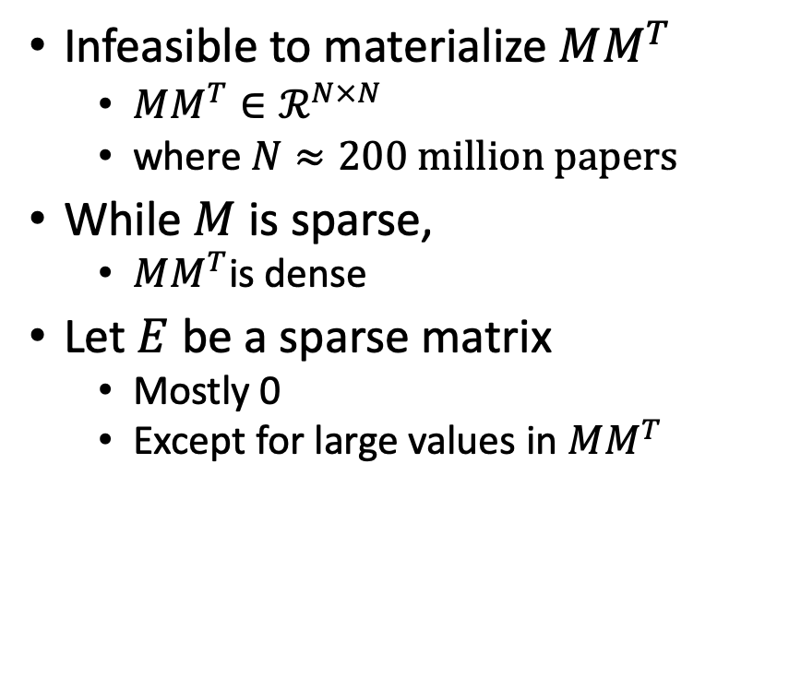

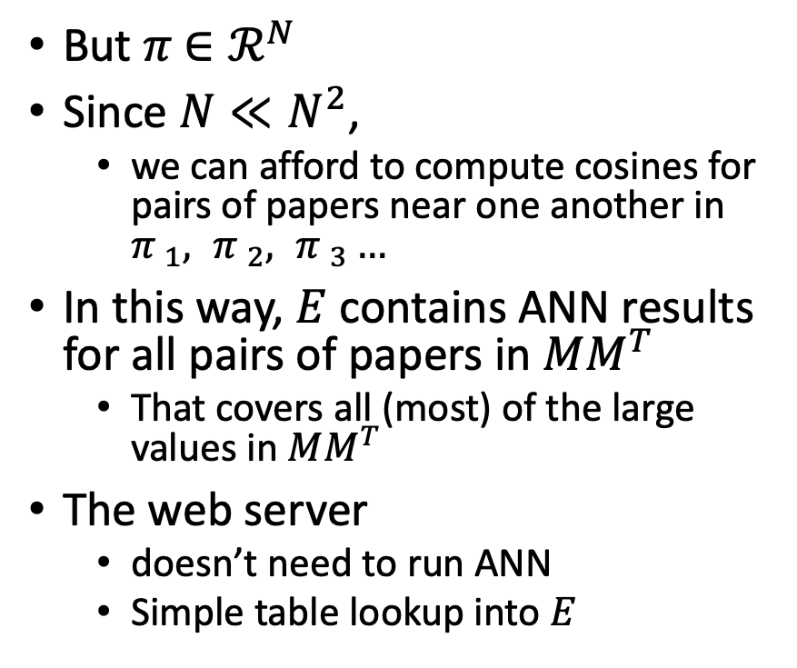
Materializing large values in $MM^{T}$
Infeasible to materialize $MM^{T}$
$MM^{T}∈ℛ^{N×N}$
where $N≈200 million papers$
While $M$ is sparse,
$MM^{T}$is dense
Let $E$ be a sparse matrix
Mostly 0
Except for large values in $MM^{T}$
But $π$ $∈ℛ^{N}$
Since $N≪N^{2}$,
we can afford to compute cosines for pairs of papers near one another in ${π }_{1}, {π }_{2}, {π }_{3}…$
In this way, $E$ contains ANN results for all pairs of papers in $MM^{T}$
That covers all (most) of the large values in $MM^{T}$
The web server
doesn’t need to run ANN
Simple table lookup into $E$

Slide 37
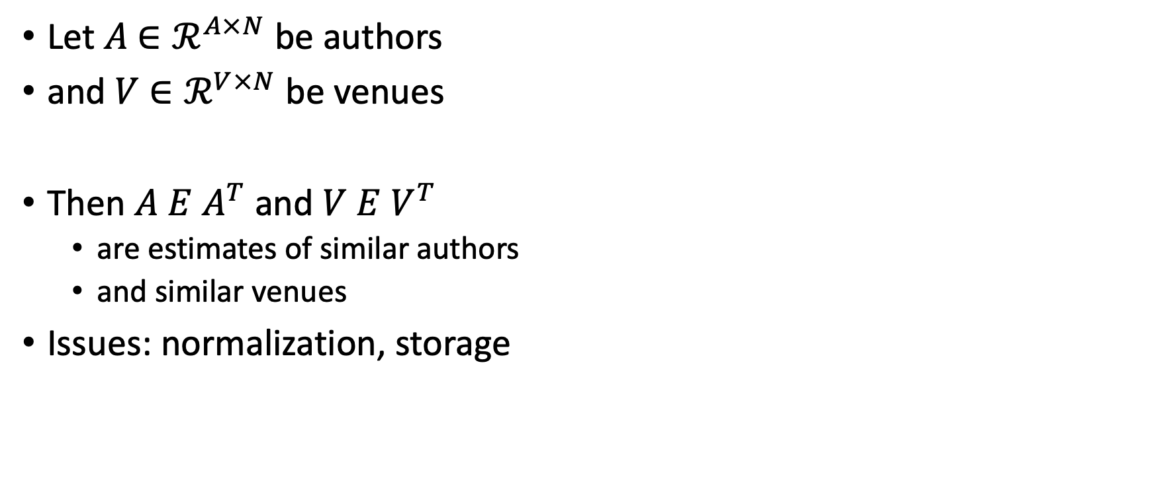
Similar Authors, Venues, etc.
Let $A$ $∈ℛ^{A×N}$ be authors
and $V$ $∈ℛ^{V×N}$ be venues
Then $A E$ $A^{T}$ and $V E$ $V^{T}$
are estimates of similar authors
and similar venues
Issues: normalization, storage

Slide 38
Conclusions/Deliverables
GitHub:
massive (but needs editing)
slides, code, reading list
pointers to large files on Globus
Web Server
Recommendations
Input: queries for documents
Output: recommendations (docs)
What Should I read? Cite?
Resources
Data behind web server:
citation graph
embeddings
indexes for approx. nearest neighbors
pairs of corpusIds with large cosines
all of the above for
Specter1, Specter2, SciNCL, ProNE
x100 bins for ProNE
Evaluations & Benchmarks
Intrinsic: Perplexity, Random Walks
Extrinsic: Local Citation Prediction

Slide 39
Agenda
1.5 hours
1.5 hours
Intro (Ken) – 20 minutes
Centroids/Related Work
(Rodolfo) – 15 minutes
Bins
(Shabnam) – 15 minutes
Forecasting over time
Losses + Time & Space
Production Runs
(Ben) – 10 minutes
Time & Space
Break – 30 minutes
Experiments
Perplexity (Abteen) – 20 minutes
Random Walks (Peter) – 10 minutes
Link Prediction (Peter) – 10 minutes
Time prediction (Melissa) – 15 minutes
GNNs (Sandeep, Hui) – 15 minutes
Deliverables/Conclusions
(Ken) – 5 minutes
Questions – 15 minutes

Slide 40

Related Work Hypothesis
Rodolfo Zevallos

Slide 41
What to do with a new paper?
Notes:
We test the models by generalizing from new papers, which means obtaining embeddings for papers that have not been used in the training dataset.
To obtain the embedding for a new paper, we used the references of paper. Then, to determine if the new embedding represents the paper effectively, we used cosine similarity to search for similar papers.
In our experiments, we selected a new paper from ACL 2023 (with the following topics...) which has 40 references.
In this figure, you can see the flow of our experiment.
In the first experiment, we used all the references to create the new embedding. In the second experiment, we only used the references from the related works section, and in the third experiment, we utilized the longest cluster obtained from the reference clustering. The embeddings for the references were obtained from Specter 2 and Prone. To obtain the new embedding, we applied the centroid method to the embeddings. Finally, we compared the new embedding obtained from each experiment with a dataset of 500 papers related to the new paper's topics.
Testeamos los modelos mediante la generalización de nuevos papers, es decir: Como obtenemos los embeddings de los papers que no han sido utilizados en los datos de entrenamiento?
Para obtener el embedding del nuevo paper, lo hacemos a partir de las referencias del paper. Luego, para saber si el nuevo embedding representa al paper, usamos similitud de cosenos para buscar papers similares.
Para los experimentos utilizamos un paper nuevo de ACL 2023 (este paper tiene como temas….) el cual tiene 40 referencias.
En el primer experimentos utilizamos todas las referencias para crear el nuevo embedding, para el segundo solo las referencias de la seccion trabajos relacionados y para el tercero el grupo mas largo obtenido de la clusterizacion de las referencias. Los embeddings de las referencias son obtenidas de Specter 2 y Prone, Para obtener el nuevo embedding aplicamos el metodo centroid a las embeddings. Finalmente compararamos el nuevo embedding obtenido de cada experimento con un dataset de de 500 paper en temas relacionados al nuevo paper.

Slide 42
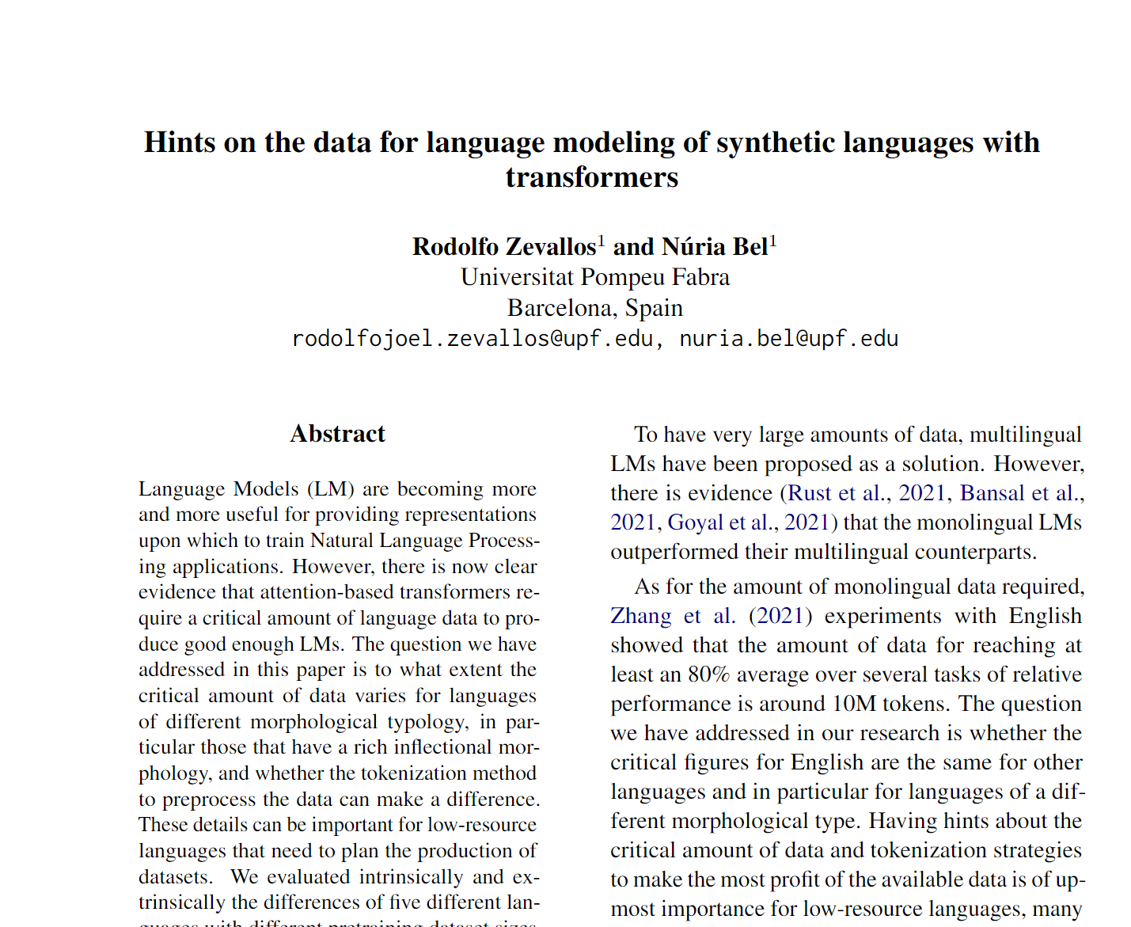
What to do with a new paper?
ACL 2023
Notes:
We test the models by generalizing from new papers, which means obtaining embeddings for papers that have not been used in the training dataset.
To obtain the embedding for a new paper, we used the references of paper. Then, to determine if the new embedding represents the paper effectively, we used cosine similarity to search for similar papers.
In our experiments, we selected a new paper from ACL 2023 (with the following topics...) which has 40 references.
In this figure, you can see the flow of our experiment.
In the first experiment, we used all the references to create the new embedding. In the second experiment, we only used the references from the related works section, and in the third experiment, we utilized the longest cluster obtained from the reference clustering. The embeddings for the references were obtained from Specter 2 and Prone. To obtain the new embedding, we applied the centroid method to the embeddings. Finally, we compared the new embedding obtained from each experiment with a dataset of 500 papers related to the new paper's topics.
Testeamos los modelos mediante la generalización de nuevos papers, es decir: Como obtenemos los embeddings de los papers que no han sido utilizados en los datos de entrenamiento?
Para obtener el embedding del nuevo paper, lo hacemos a partir de las referencias del paper. Luego, para saber si el nuevo embedding representa al paper, usamos similitud de cosenos para buscar papers similares.
Para los experimentos utilizamos un paper nuevo de ACL 2023 (este paper tiene como temas….) el cual tiene 40 referencias.
En el primer experimentos utilizamos todas las referencias para crear el nuevo embedding, para el segundo solo las referencias de la seccion trabajos relacionados y para el tercero el grupo mas largo obtenido de la clusterizacion de las referencias. Los embeddings de las referencias son obtenidas de Specter 2 y Prone, Para obtener el nuevo embedding aplicamos el metodo centroid a las embeddings. Finalmente compararamos el nuevo embedding obtenido de cada experimento con un dataset de de 500 paper en temas relacionados al nuevo paper.

Slide 43
What to do with a new paper?
ACL 2023
Task: find similar papers
Notes:
We test the models by generalizing from new papers, which means obtaining embeddings for papers that have not been used in the training dataset.
To obtain the embedding for a new paper, we used the references of paper. Then, to determine if the new embedding represents the paper effectively, we used cosine similarity to search for similar papers.
In our experiments, we selected a new paper from ACL 2023 (with the following topics...) which has 40 references.
In this figure, you can see the flow of our experiment.
In the first experiment, we used all the references to create the new embedding. In the second experiment, we only used the references from the related works section, and in the third experiment, we utilized the longest cluster obtained from the reference clustering. The embeddings for the references were obtained from Specter 2 and Prone. To obtain the new embedding, we applied the centroid method to the embeddings. Finally, we compared the new embedding obtained from each experiment with a dataset of 500 papers related to the new paper's topics.
Testeamos los modelos mediante la generalización de nuevos papers, es decir: Como obtenemos los embeddings de los papers que no han sido utilizados en los datos de entrenamiento?
Para obtener el embedding del nuevo paper, lo hacemos a partir de las referencias del paper. Luego, para saber si el nuevo embedding representa al paper, usamos similitud de cosenos para buscar papers similares.
Para los experimentos utilizamos un paper nuevo de ACL 2023 (este paper tiene como temas….) el cual tiene 40 referencias.
En el primer experimentos utilizamos todas las referencias para crear el nuevo embedding, para el segundo solo las referencias de la seccion trabajos relacionados y para el tercero el grupo mas largo obtenido de la clusterizacion de las referencias. Los embeddings de las referencias son obtenidas de Specter 2 y Prone, Para obtener el nuevo embedding aplicamos el metodo centroid a las embeddings. Finalmente compararamos el nuevo embedding obtenido de cada experimento con un dataset de de 500 paper en temas relacionados al nuevo paper.

Slide 44
What to do with a new paper?
ACL 2023
Task: find similar papers
Does the new paper have an ID to generate its vector in Specter 2 or Prone model?
Notes:
We test the models by generalizing from new papers, which means obtaining embeddings for papers that have not been used in the training dataset.
To obtain the embedding for a new paper, we used the references of paper. Then, to determine if the new embedding represents the paper effectively, we used cosine similarity to search for similar papers.
In our experiments, we selected a new paper from ACL 2023 (with the following topics...) which has 40 references.
In this figure, you can see the flow of our experiment.
In the first experiment, we used all the references to create the new embedding. In the second experiment, we only used the references from the related works section, and in the third experiment, we utilized the longest cluster obtained from the reference clustering. The embeddings for the references were obtained from Specter 2 and Prone. To obtain the new embedding, we applied the centroid method to the embeddings. Finally, we compared the new embedding obtained from each experiment with a dataset of 500 papers related to the new paper's topics.
Testeamos los modelos mediante la generalización de nuevos papers, es decir: Como obtenemos los embeddings de los papers que no han sido utilizados en los datos de entrenamiento?
Para obtener el embedding del nuevo paper, lo hacemos a partir de las referencias del paper. Luego, para saber si el nuevo embedding representa al paper, usamos similitud de cosenos para buscar papers similares.
Para los experimentos utilizamos un paper nuevo de ACL 2023 (este paper tiene como temas….) el cual tiene 40 referencias.
En el primer experimentos utilizamos todas las referencias para crear el nuevo embedding, para el segundo solo las referencias de la seccion trabajos relacionados y para el tercero el grupo mas largo obtenido de la clusterizacion de las referencias. Los embeddings de las referencias son obtenidas de Specter 2 y Prone, Para obtener el nuevo embedding aplicamos el metodo centroid a las embeddings. Finalmente compararamos el nuevo embedding obtenido de cada experimento con un dataset de de 500 paper en temas relacionados al nuevo paper.

Slide 45
What to do with a new paper?
ACL 2023
Task: find similar papers
Does the new paper have an ID to generate its vector in Specter 2 or Prone model?
NO
Notes:
We test the models by generalizing from new papers, which means obtaining embeddings for papers that have not been used in the training dataset.
To obtain the embedding for a new paper, we used the references of paper. Then, to determine if the new embedding represents the paper effectively, we used cosine similarity to search for similar papers.
In our experiments, we selected a new paper from ACL 2023 (with the following topics...) which has 40 references.
In this figure, you can see the flow of our experiment.
In the first experiment, we used all the references to create the new embedding. In the second experiment, we only used the references from the related works section, and in the third experiment, we utilized the longest cluster obtained from the reference clustering. The embeddings for the references were obtained from Specter 2 and Prone. To obtain the new embedding, we applied the centroid method to the embeddings. Finally, we compared the new embedding obtained from each experiment with a dataset of 500 papers related to the new paper's topics.
Testeamos los modelos mediante la generalización de nuevos papers, es decir: Como obtenemos los embeddings de los papers que no han sido utilizados en los datos de entrenamiento?
Para obtener el embedding del nuevo paper, lo hacemos a partir de las referencias del paper. Luego, para saber si el nuevo embedding representa al paper, usamos similitud de cosenos para buscar papers similares.
Para los experimentos utilizamos un paper nuevo de ACL 2023 (este paper tiene como temas….) el cual tiene 40 referencias.
En el primer experimentos utilizamos todas las referencias para crear el nuevo embedding, para el segundo solo las referencias de la seccion trabajos relacionados y para el tercero el grupo mas largo obtenido de la clusterizacion de las referencias. Los embeddings de las referencias son obtenidas de Specter 2 y Prone, Para obtener el nuevo embedding aplicamos el metodo centroid a las embeddings. Finalmente compararamos el nuevo embedding obtenido de cada experimento con un dataset de de 500 paper en temas relacionados al nuevo paper.

Slide 46
What to do with a new paper?
ACL 2023
Task: find similar papers
Does the new paper have an ID to generate its vector in Specter 2 or Prone model?
NO
How to create the vector of my new paper?
Notes:
We test the models by generalizing from new papers, which means obtaining embeddings for papers that have not been used in the training dataset.
To obtain the embedding for a new paper, we used the references of paper. Then, to determine if the new embedding represents the paper effectively, we used cosine similarity to search for similar papers.
In our experiments, we selected a new paper from ACL 2023 (with the following topics...) which has 40 references.
In this figure, you can see the flow of our experiment.
In the first experiment, we used all the references to create the new embedding. In the second experiment, we only used the references from the related works section, and in the third experiment, we utilized the longest cluster obtained from the reference clustering. The embeddings for the references were obtained from Specter 2 and Prone. To obtain the new embedding, we applied the centroid method to the embeddings. Finally, we compared the new embedding obtained from each experiment with a dataset of 500 papers related to the new paper's topics.
Testeamos los modelos mediante la generalización de nuevos papers, es decir: Como obtenemos los embeddings de los papers que no han sido utilizados en los datos de entrenamiento?
Para obtener el embedding del nuevo paper, lo hacemos a partir de las referencias del paper. Luego, para saber si el nuevo embedding representa al paper, usamos similitud de cosenos para buscar papers similares.
Para los experimentos utilizamos un paper nuevo de ACL 2023 (este paper tiene como temas….) el cual tiene 40 referencias.
En el primer experimentos utilizamos todas las referencias para crear el nuevo embedding, para el segundo solo las referencias de la seccion trabajos relacionados y para el tercero el grupo mas largo obtenido de la clusterizacion de las referencias. Los embeddings de las referencias son obtenidas de Specter 2 y Prone, Para obtener el nuevo embedding aplicamos el metodo centroid a las embeddings. Finalmente compararamos el nuevo embedding obtenido de cada experimento con un dataset de de 500 paper en temas relacionados al nuevo paper.

Slide 47
Our solution: new vector from the paper references.
New Paper
Get Vectors
(Specter 2 or Prone)
Vectors
New
Vector
Centroid Method
Notes:
Get paper references
To obtain the embeddings of each reference using Specter 2 or Prone
Applying centroid method to the references to get a new embedding

Slide 48
Our solution: new vector from the paper references.
Now! We can find similar papers
New Paper
Get Vectors
(Specter 2 or Prone)
Vectors
New
Vector
Centroid Method
Notes:
Get paper references
To obtain the embeddings of each reference using Specter 2 or Prone
Applying centroid method to the references to get a new embedding

Slide 49
Our solution: new vector from the paper references.
Now! We can find similar papers
New
Vector
New Paper
Get Vectors
(Specter 2 or Prone)
INPUT
Vectors
Nearest Neighbors
OUTPUT
New
Vector
Centroid Method
Recommendations
Notes:
Get paper references
To obtain the embeddings of each reference using Specter 2 or Prone
Applying centroid method to the references to get a new embedding

Slide 50
Using all reference citations Cosine
Prone
Impact of Tokenization on Language Models: An Analysis for Turkish
Cross-Lingual Named Entity Recognition Using Parallel Corpus: A New Approach Using XLM-RoBERTa Alignment
Specter 2
oLMpics-On What Language Model Pre-training Captures
Fast, Effective, and Self-Supervised: Transforming Masked Language Models into Universal Lexical and Sentence Encoders
97%
95%
96%
95%
I believe that Prone results are closer to my paper.

Slide 51
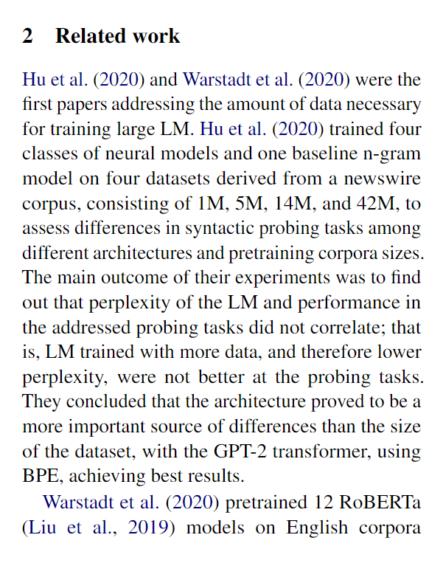
Related Work Hypothesis
Related work references seem to represent entire papers.

Slide 52
Using only related work ref. citations Cosine
Prone
Impact of Tokenization on Language Models: An Analysis for Turkish
RobeCzech: Czech RoBERTa, a monolingual contextualized language representation model
Specter 2
oLMpics-On What Language Model Pre-training Captures
Fast, Effective, and Self-Supervised: Transforming Masked Language Models into Universal Lexical and Sentence Encoders
99%
95%
97%
95%
I believe that Prone results are closer to my paper.

Slide 53
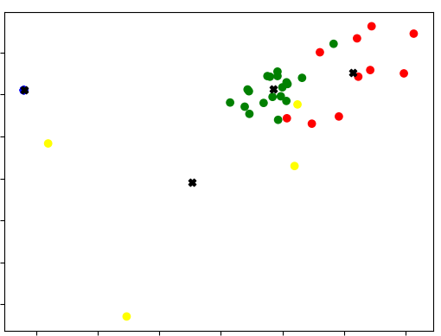
Related Work Neighborhood Experiment
Green dots represent Related Work reference citations
Notes:
We cluster our references, but (question)
Take the green references because we believe they are almost the same as those of the related work.
we take the longest and most compact group
And they are the most closely related to each other and with the paper.

Slide 54
Using all ref citations with clustering Cosine
Prone
Phonologically Informed Edit Distance Algorithms for Word Alignment with Low-Resource Languages
A Basic Language Technology Toolkit for Quechua
Specter 2
On the Stability of Fine-tuning BERT: Misconceptions, Explanations, and Strong Baselines
Probing Across Time: What Does RoBERTa Know and When?
92%
90%
92%
91%
I believe that Prone results are closer to my paper.

Slide 55
Related Work Hypothesis
Cosine_similarity(V_prone, V_rw) > Cosine_similarity(V_prone, V_all)

Slide 56
Related Work Experiments
400k papers
Organized by Martin Dočekal (PhD student, BRNO UNIVERSITY OF TECHNOLOGY, Czech Republic)
Related Work annotated dataset
Corpus ids mapped to Semantic Scholar ids
"paper_id":54955648,
"rw_citations":[3045997,2770517,5569544,36379,1665288,74632109,2223771],
"Other_citations":[16395612,14432142]

Slide 57
Related Work Experiments
Vector representations of referenced papers
Specter 1 and 2
Prone
Centroids
related work references
non-related work references
ALL references

Slide 58
Related Work Experiments
Introduction Ref1, Ref2, Ref3
Related Work Ref4, Ref5, Ref6
Conclusion Ref7, Ref8, Ref9
9 References
3 Introduction
3 Rel Work
3 Conclusion
ALL References Vector = 9 References (V_all)
Rel Work References Vector = 3 References (V_rw)
Sample Paper

Slide 59
Related Work Experiments
get_paper_embedding(sample_paper)
model
V_model
Introduction Ref1, Ref2, Ref3
Related Work Ref4, Ref5, Ref6
Conclusion Ref7, Ref8, Ref9
get_centroid_vector(All References) = V_all
Compare
get_centroid_vector(Related Work References) = V_rw

Slide 60
Related Work Experiments (Prone)
Comparison of Cosine Similarity: V_rw and V_all
Notes:
If you just compute the vector from rw, it is usually better than using all of the references. Isn’t clear what the two conditions are.

Slide 61
Related Work Experiments (Specter 2)
Comparison of Cosine Similarity: V_rw and V_all
Notes:
times that one cosine is better than the other

Slide 62
Is possible predict new vectors (V_model)?
V_rw + V_nrw = V_predic ≈ V_model
V_rw = V_predic ≈ V_model
We experiment with predicting the entire vector using all references and only related work references.

Slide 63
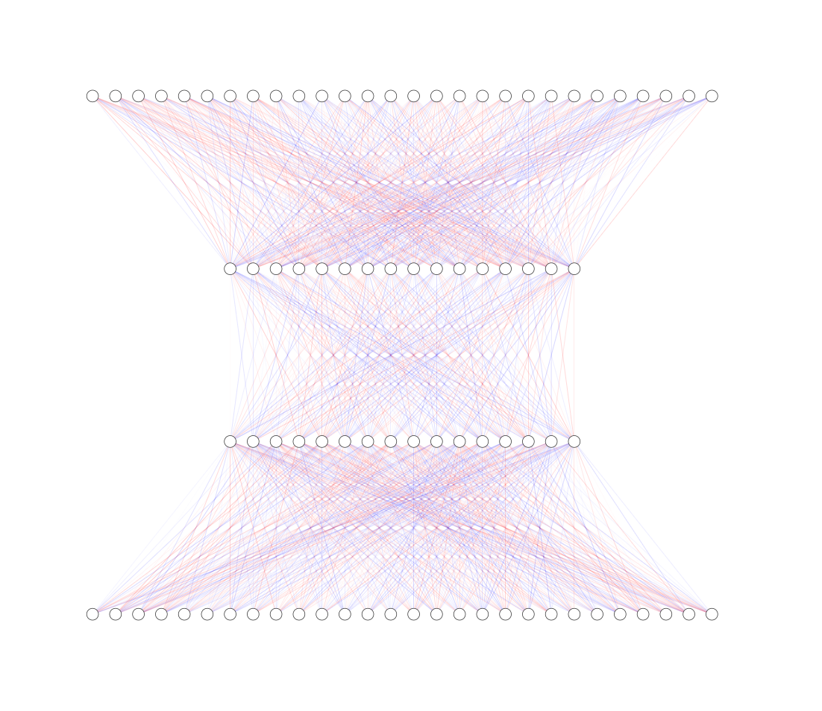
Related Work Experiments
V_predic
We built a neural network to predict the V_model
We used Martin's 400k paper archive
Our NN was trained with a lr of 5e-5, in 3 epochs, using AdamW as an optimizer, in addition, we use a dropout of 0.2 and a batch of 8
Our Neural Network
V_rw + V_nrw / V_rw

Slide 64
Related Work Experiments

Slide 65
Related Work Experiments

Slide 66
Conclusion
The centroid vector of the references approximates the vector of the model.
The centroid vector of Related Work references is better than use all references.
Using a clustering method helps to get the related work references in case you don't have them.
The vector generated by the neural model is closer to the V_model than the vector of related work references

Slide 67
The Case for Bins
Shabnam

Slide 68
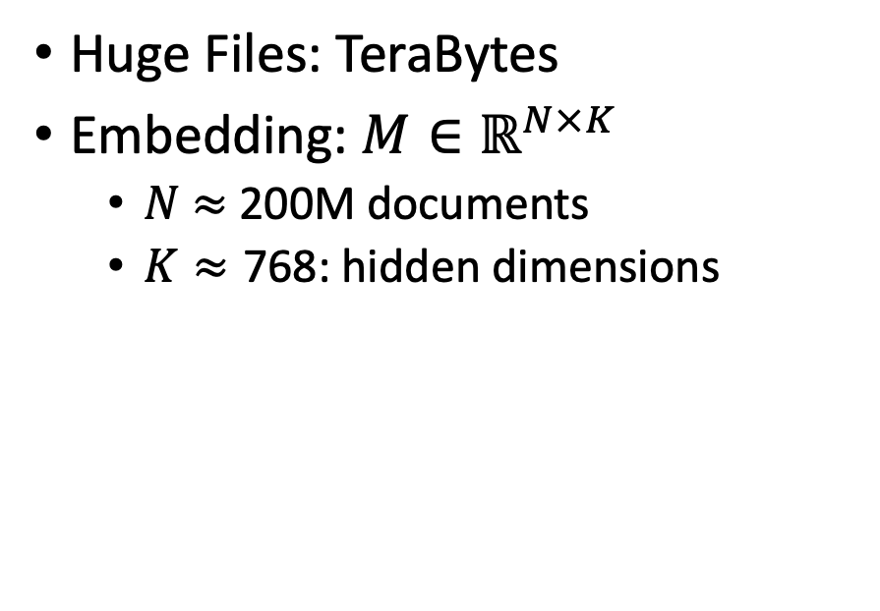
Scale: Both a Blessing and a Curse
Curse (Ben’s Problem)
Blessing (Abteen & Peter’s Lucky Day)
Huge Files: TeraBytes
Embedding: $M∈ℝ^{N×K}$
$N$ $≈$ 200M documents
$K≈\text{768}$: hidden dimensions
Network Effects (Metcalfe’s Law)
Rich get richer (next slide)
More good stuff to find

Slide 69


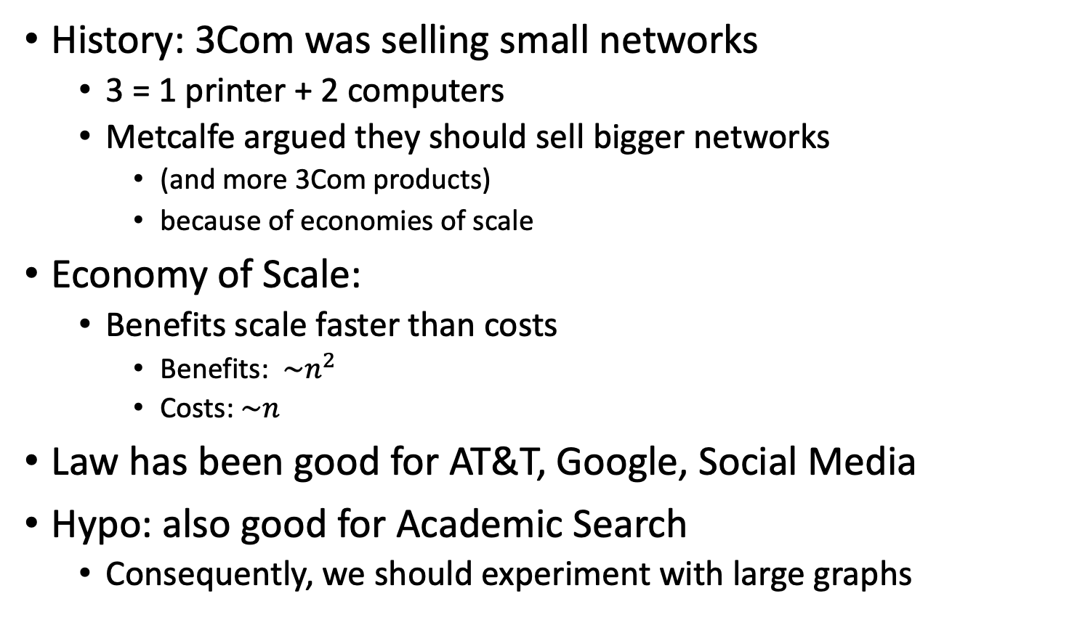
Metcalfe’s Law (Network Effects)
History: 3Com was selling small networks
3 = 1 printer + 2 computers
Metcalfe argued they should sell bigger networks
(and more 3Com products)
because of economies of scale
Economy of Scale:
Benefits scale faster than costs
Benefits: $\sim n^{2}$
Costs:$\sim n$
Law has been good for AT&T, Google, Social Media
Hypo: also good for Academic Search
Consequently, we should experiment with large graphs

Slide 70
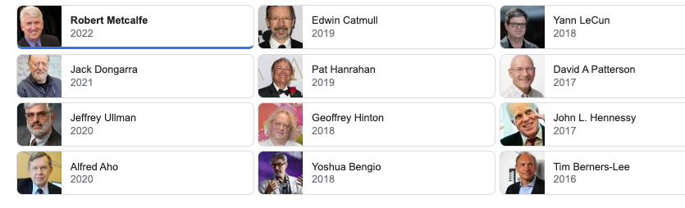
Turing Award/Winners

Slide 71
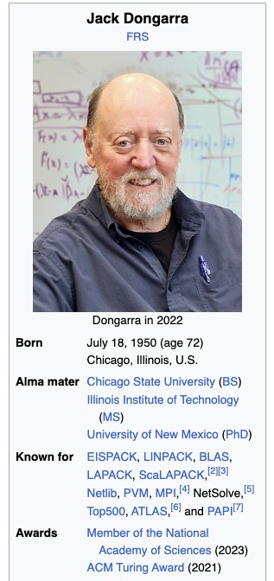
Turing Awards: Metcalfe’s Law, Deep Nets, Linear Algebra
Metclalfe’s Law: Metcalfe
Deep Nets: Hinton, Bengio, LeCun
Linear Algebra: Dongarra

Slide 72
Opportunities
Encourage practical solutions to real problems
Recommendations: What should I read? Cite?
Too many benchmarks are unrealistic (small, clean)
Realities
Literature is large and growing (doubles every 9 years)
Dirty Data (many values are missing/incorrect)
Scale
How do space, time and loss scale with size of citation graph?
Forecasting: short-term predictions are easier than long-term

Slide 73
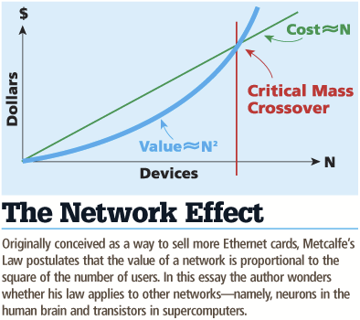
Network Effects: What is the Power of Scale?
Many benchmarks return a single number (figure of merit)
How performance scales with time and the size of the problem
Metcalfe's Law is a blessing
Cost scales in N, benefit scales in N^2
There is an opportunity for academics to benefit from the network effect

Slide 74
Spoiler Alert: Better-Together Conjectures
Multiple representations are helpful
for missing values (and bad values)
If abstracts are missing, use links
If links are missing, use abstracts
and for graphs of different sizes
When graphs are small (benchmarks):
Text >> Links
when graphs are large:
Links >> Text (Metcalfe’s Law)
Other
(31%)

Slide 75
What is the Effect of Scale and Time?
Encourage practical solutions to real problems
Recommendations: What should I read? Cite?
Too many benchmarks are unrealistic (small, clean)
Realities
Literature is large and growing (doubles every 9 years)
Dirty Data (many values are missing/incorrect)
Scale
How do space, time, and loss scale with size of citation graph?
Forecasting: short-term predictions are easier than long-term

Slide 76
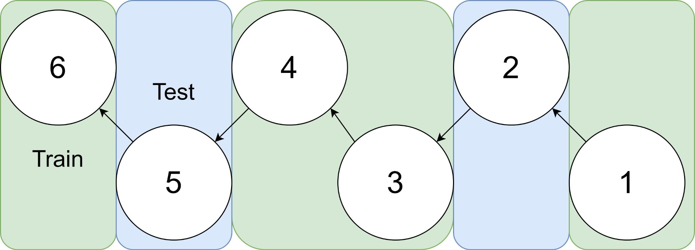
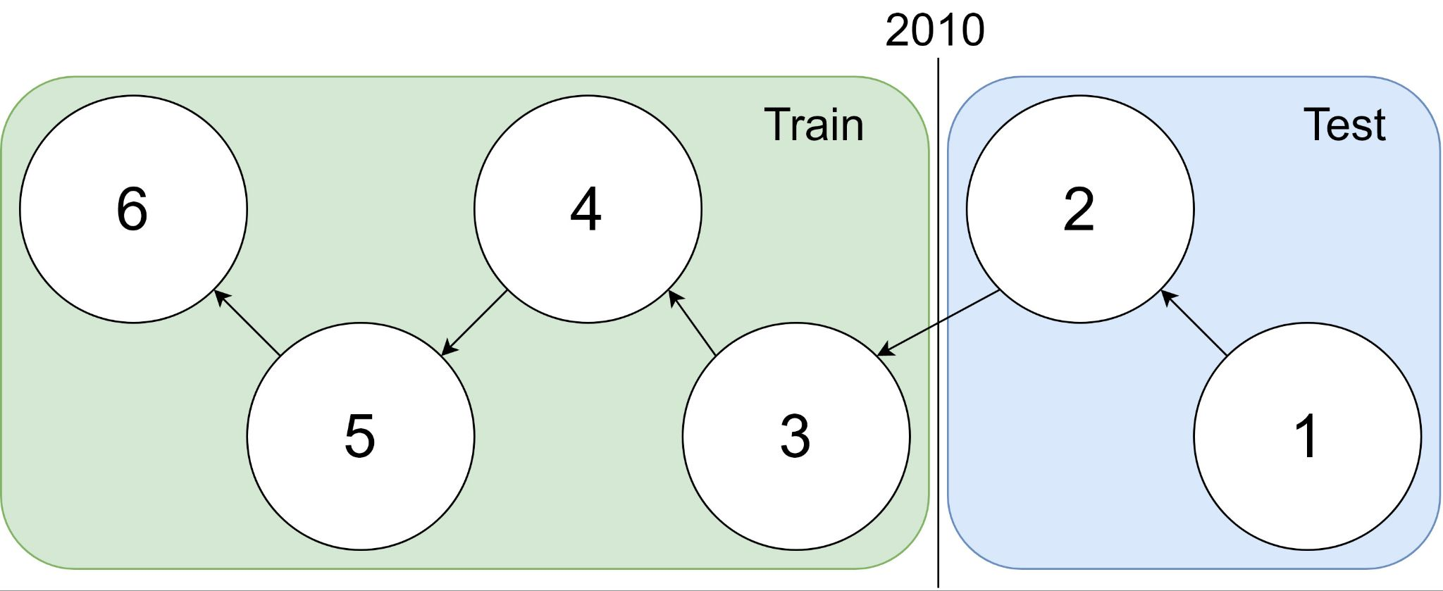
Example: 1 cites 2, 2 cites 3, … 5 cites 6
Traditional Train-Test Split (Non-Causal)
idx | Pub Year | Paper Title
1 | 2018 | [...] Photofragment imaging
2 | 2016 | Convenient probe of S(1D2)[...]
3 | 2005 | Megapixel ion imaging [...]
4 | 2003 | Direct current slice imaging [...]
5 | 1995 | profiles of Cl(2Pj) photofragments [...]
6 | 1988 | Adiabatic dissociation of [...]
Proposed Train-Test Splits (Causal)
Notes:
No asymmetry of time - how to reduce to a soundbite
Audience soundbites
‘Almost all studies in ml do test-train split’ that’s a bad idea when you have time

Slide 77
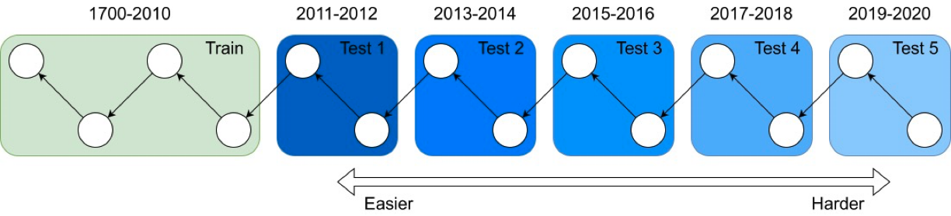
It's tough to make predictions, especially about the future ― Yogi Berra
Forecasting: short-term predictions are easier than long-term

Slide 78
Assign 200M papers to 100 bins (by time)
Sort 200M papers by publication date
Output: Split papers into 100 bins, with 2M papers/bin
Because of exponential growth
(literature doubles every 9 years)
older bins span more time, and
newer bins span less time
Bin 99
………
Bin 0
Time
Notes:
mention equal # papers
consider replacing w/ diagram

Slide 79
Create 100 ProNE Embeddings
Create a graph for each bin
Graph contains the papers in the bin (plus their edges)
Create a cumulative graph for each bin
Sum graphs for the current bin, plus all previous bins
100 ProNE Embeddings:
Run ProNE on 100 cumulative graphs

Slide 80
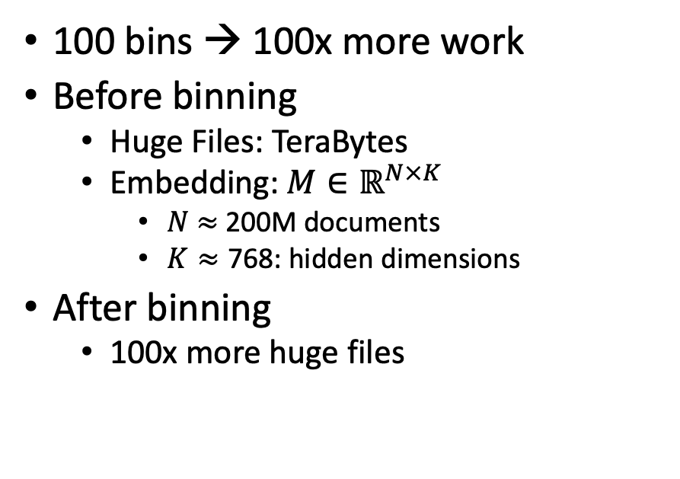
Scale (after binning): Both a Blessing and a Curse
Curse (Ben’s Problem)
Blessing (Abteen & Peter’s Lucky Day)
100 bins → 100x more work
Before binning
Huge Files: TeraBytes
Embedding: $M∈ℝ^{N×K}$
$N$ $≈$ 200M documents
$K≈\text{768}$: hidden dimensions
After binning
100x more huge files
Abteen:
Perplexity varies by bin
in systematic ways
Peter:
Use bins to show
Short-term forecasting is easier
than long-term forecasting
Better together:
Text is more useful
when links are least useful
(small graphs)

Slide 81
Deliverables
GitHub:
massive (but needs editing)
slides, code, reading list
pointers to large files on Globus
Web Server
Recommendations
Input: queries for documents
Output: recommendations (docs)
What Should I read? Cite?
Resources
Data behind web server:
citation graph
embeddings
indexes for approx. nearest neighbors
pairs of corpusIds with large cosines
all of the above for
Specter1, Specter2, SciNCL, ProNE
x100 bins for ProNE
Evaluations & Benchmarks
Intrinsic: Perplexity, Random Walks
Extrinsic: Local Citation Prediction

Slide 82
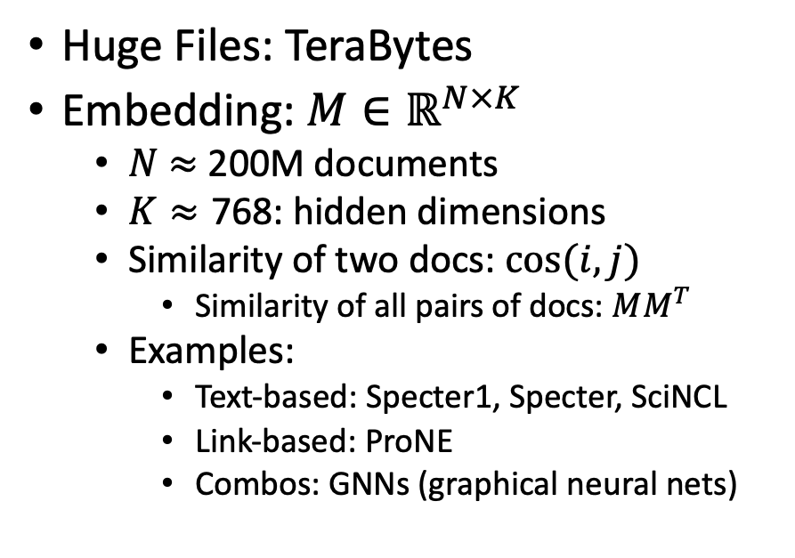
Scale: Both a Blessing and a Curse
Curse
Blessing
Huge Files: TeraBytes
Embedding: $M∈ℝ^{N×K}$
$N$ $≈$ 200M documents
$K≈\text{768}$: hidden dimensions
Similarity of two docs: $cos(i,j)⁡$
Similarity of all pairs of docs: $MM^{T}$
Examples:
Text-based: Specter1, Specter, SciNCL
Link-based: ProNE
Combos: GNNs (graphical neural nets)
Network Effects (Metcalfe’s Law)
Rich get richer
Approximate Nearest Neighbors
Works better on larger graphs
Citation Recommendation
Forecasting with text-based + link-base works better
Year prediction
Text-based + link-base works better

Slide 83
Production Runs
Ben Irving

Slide 84
Final Presentation
Ben Irving

Slide 85
Overview
Overall goal
Optimize Prone, and produce embeddings for general use
Notes:
Ben

Slide 86
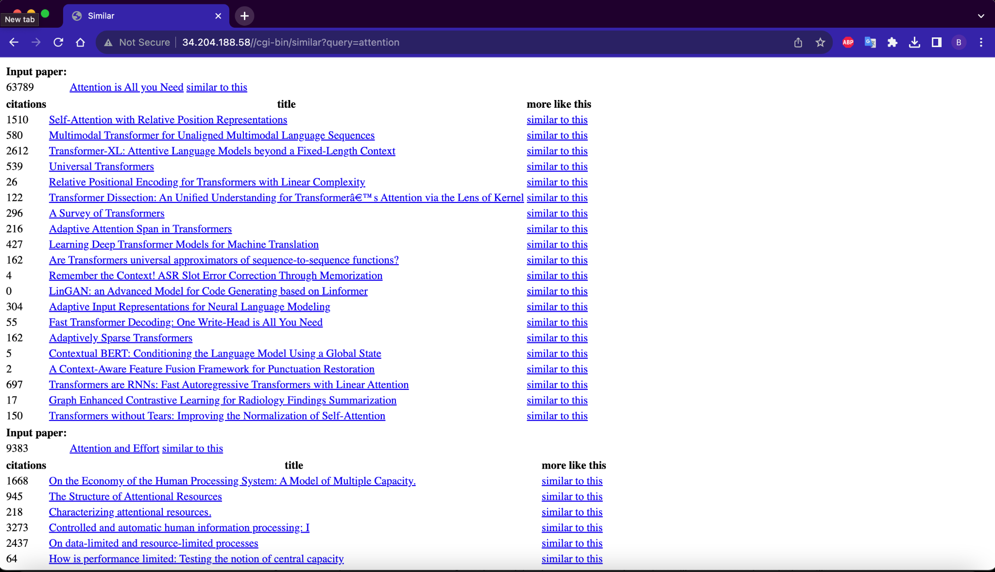

Slide 87
Model and limitations
Limited space (<= 2 TB per job)
Limited time (<= 1 day per job)
Without dividing code: 2 TB of memory, 3.8 days
Prefactor
Prone.py
Chebyshev
Finish step
Notes:
Ben

Slide 88
Optimizations
Cython
float32 → float16
Notes:
Ben

Slide 89
Cython
Superset of Python (use more C in Python)
Still runs in Python runtime, but not compiled to Python bytecode. Instead compiled to native machine code (whatever your microprocessor interprets)
Original code
PVM
Machine code
Notes:
Ben
For instance, . Cython compiler doesn’t call python torch library when releasing the global clock is released.

Slide 90
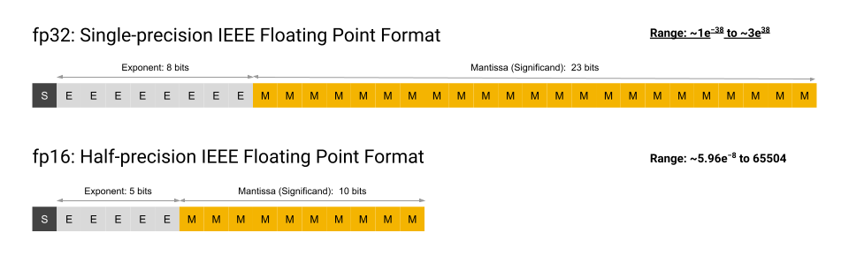
Float32 → Float16
4 decimal places (for float16) vs 8 (for float32)
Problem: (A lot of cpus don’t support it, particularly x86 architectures)
Courtesy of Google
Notes:
Ben

Slide 91
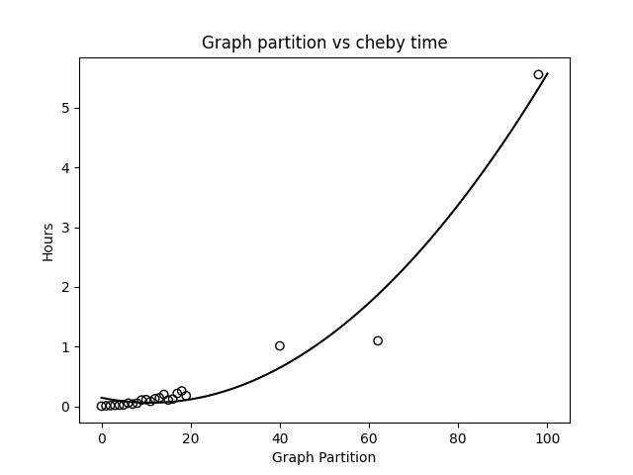
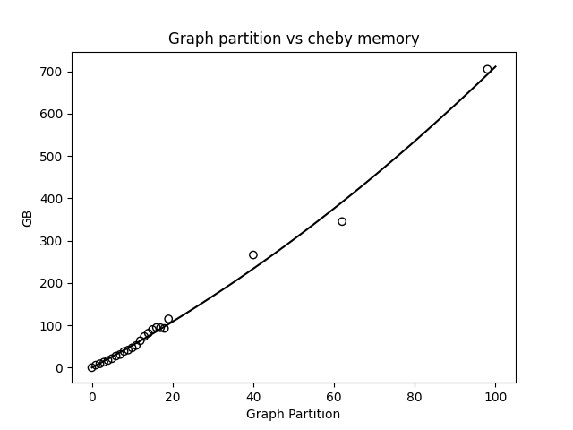
Pre-optimization (chebyshev step)

Slide 92
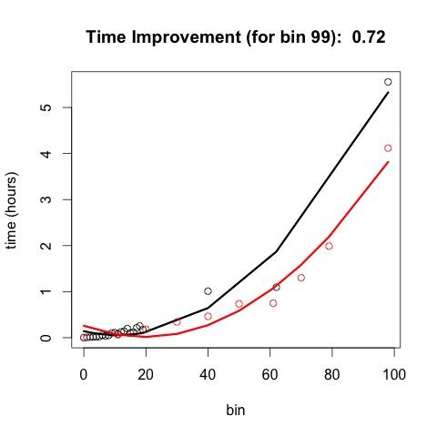
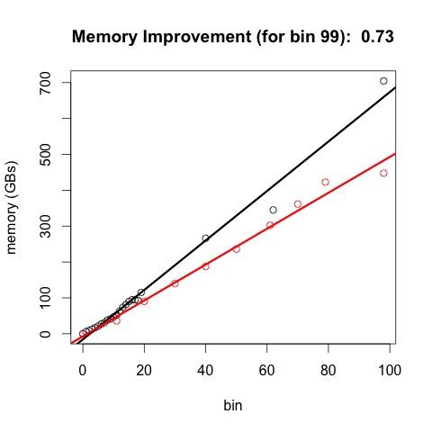
Post optimization (red stuff)
28% time improvement
27% memory improvement
Notes:
Ben
(generally speaking, memory utilized is some simple multiplication of the input mem ← plot this out)

Slide 93
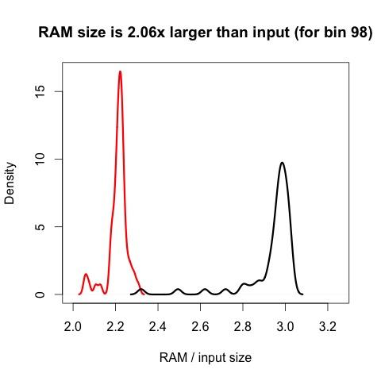
RAM comparison (density)

Slide 94


Pre-optimization (finish step)

Slide 95


Finish with optimizations (red line)
20% time improvement
23% memory improvement
Notes:
Ben

Slide 96

Bins 80% done
Total compute time: 2000 hours (83 days worth) Total compute memory utilization: 100 TB

Slide 97
backup

Slide 98
Scale (after binning): Both a Blessing and a Curse
Curse (Ben’s Problem)
Blessing (Abteen & Peter’s Lucky Day)
100 bins → 100x more work
Before binning
Huge Files: TeraBytes
Embedding: $M∈ℝ^{N×K}$
$N$ $≈$ 200M documents
$K≈\text{768}$: hidden dimensions
After binning
100x more huge files
Abteen:
Perplexity varies by bin
in systematic ways
Peter:
Use bins to show
Short-term forecasting is easier
than long-term forecasting
Better together:
Text is more useful
when links are least useful
(small graphs)

Slide 100
Overview
What I’m working on
Optimization stuff
Starting on related work stuff
Notes:
Ben

Slide 101
Model and limitations
Limited space (<= 2 TB per job)
Limited time (<= 1 day per job)
Without dividing code: 2 TB of memory, 3.8 days
Prefactor
Prone.py
Chebyshev
Finish step
Notes:
Ben

Slide 102
Optimizations
Cython
float32 → float16
Notes:
Ben

Slide 103
Cython
Superset of Python (use more C in Python)
Still runs in Python runtime, but not compiled to Python bytecode. Instead compiled to native machine code (whatever your microprocessor interprets)
Original code
PVM
Machine code
Notes:
Ben
For instance, . Cython compiler doesn’t call python torch library when releasing the global clock is released.

Slide 104
Float32 → Float16
4 decimal places (for float16) vs 8 (for float32)
Problem: (A lot of cpus don’t support it, particularly x86 architectures)
Courtesy of Google
Notes:
Ben

Slide 105
Pre-optimization (cheby step)

Slide 106
Post optimization (red stuff)
Notes:
Ben
(generally speaking, memory utilized is some simple multiplication of the input mem ← plot this out)

Slide 107
RAM comparison (density)

Slide 108
Pre-optimization (finish step)

Slide 109
Finish with optimizations (red line)
Notes:
Ben

Slide 110
Conclusion: Bins → Big Effort (but worth it) Come back after break to see why

Slide 111
Related Work Experiments
get_paper_embedding(sample_paper)
model
Paper
Introduction Ref1, Ref2, Ref3
Related Work Ref4, Ref5, Ref6
Conclusion Ref7, Ref8, Ref9
Intro References Vector = 3 References
Compare and Predict
Rel Work References Vector = 3 References
Conclusion References Vector = 3 References

Slide 112

Related Work Experiments (Before)

Slide 113

Deeper Networks (with layernorm, and GELU activation)
With improvements, V_predic now outperforms V_rw in 76.2% of cases.

Slide 114
thanks

Slide 115
Example: 1 cites 2, 2 cites 3, … 5 cites 6
Traditional Train-Test Split (Non-Causal)
idx | Pub Year | Paper Title
1 | 2018 | [...] Photofragment imaging
2 | 2016 | Convenient probe of S(1D2)[...]
3 | 2005 | Megapixel ion imaging [...]
4 | 2003 | Direct current slice imaging [...]
5 | 1995 | profiles of Cl(2Pj) photofragments [...]
6 | 1988 | Adiabatic dissociation of [...]
Proposed Train-Test Splits (Causal)
Notes:
No asymmetry of time - how to reduce to a soundbite
Audience soundbites
‘Almost all studies in ml do test-train split’ that’s a bad idea when you have time

